Slide 1
Testing on Real and Synthetic Data
07/18/2023

Slide 2
Bootstrap Average for Real Data

Slide 3
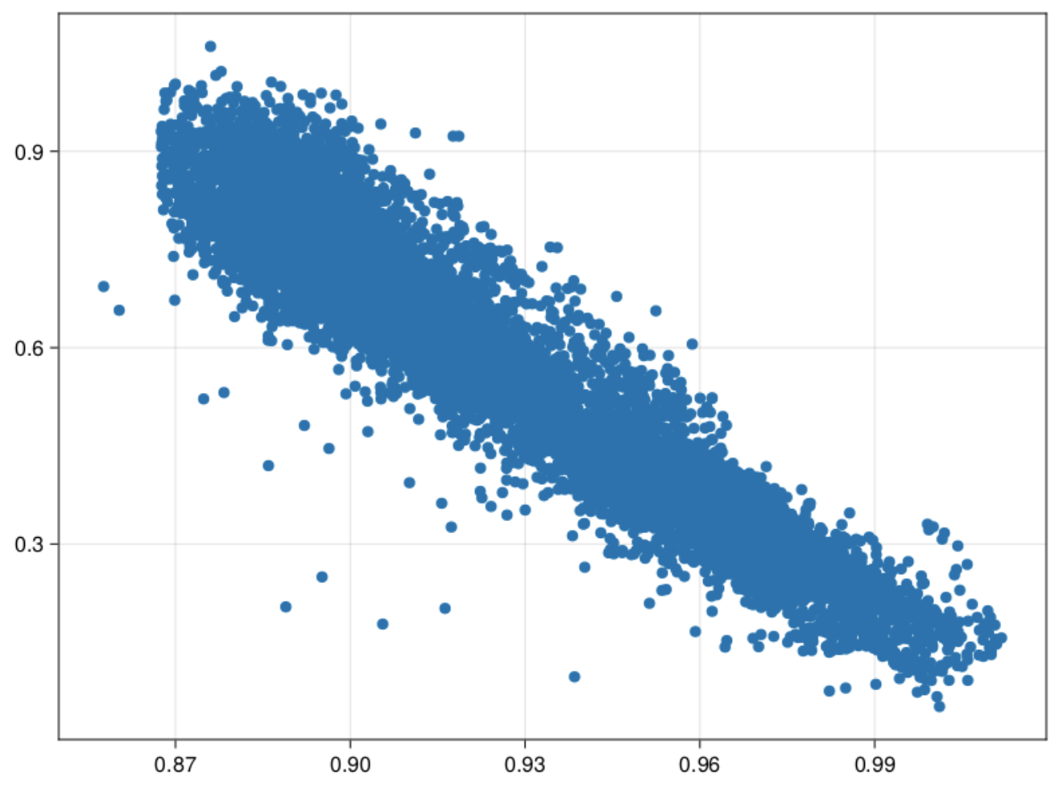
Data Plotted

Slide 4
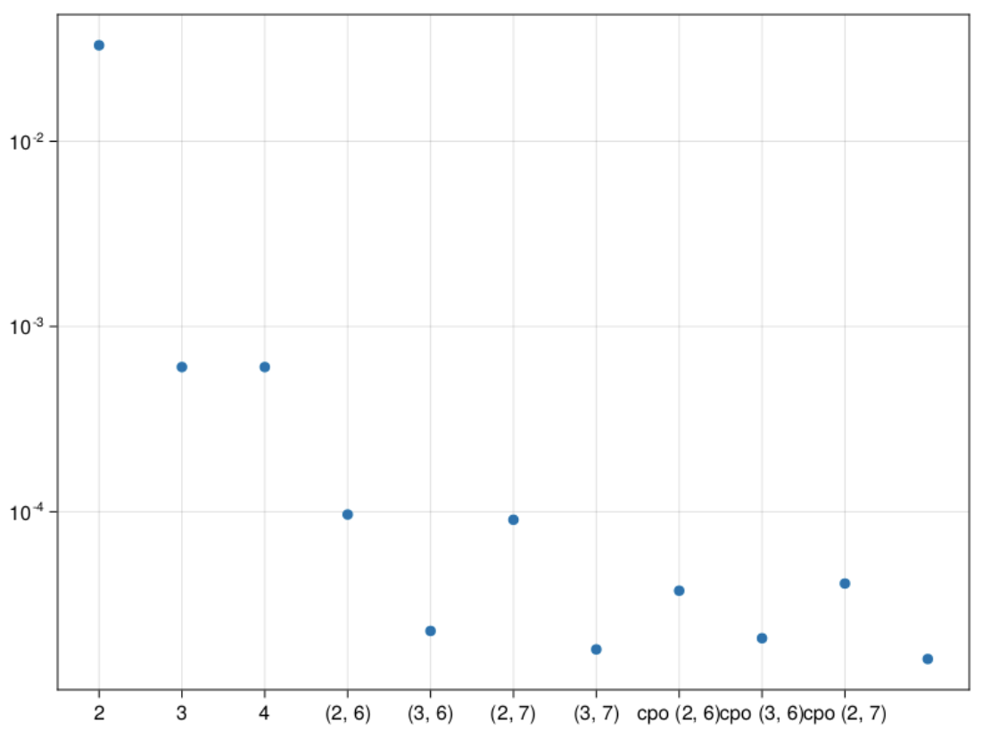
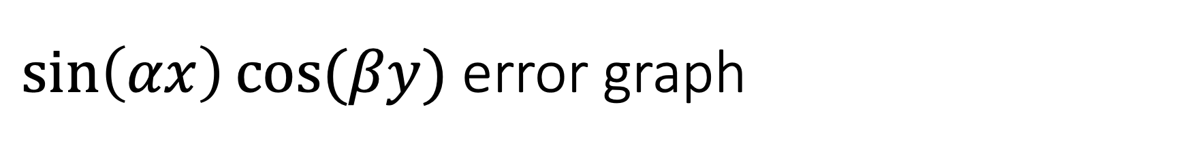
$\sin\left(αx\right)cos⁡(βy)$ error graph
2 – 2 stored moments
3 – 3 stored moments
4 – 4 stored moments
(2,6) – 2 stored, 6 pseudo
(3,6) – 3 stored, 6 pseudo
(2,7) - 2 stored, 7 pseudo
(3,7) – 3 stored, 7 pseudo
cpo(2,6) – max cumulant order 2, order 6
cpo(3,6) – max cumulant order 3, order 6
cpo(2,7) – max cumulant order 3, order 7
cpo(3,7) – max cumulant order 3, order 7

Slide 5
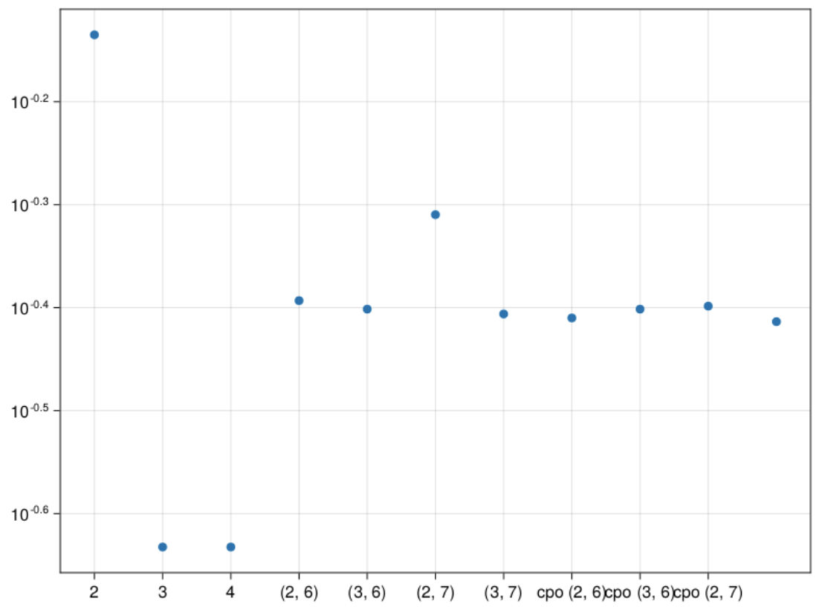
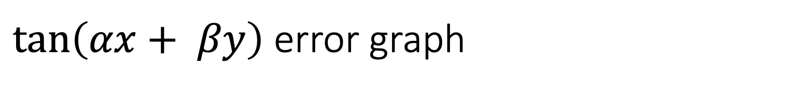
$\tan\left(αx+ βy\right)$ error graph
2 – 2 stored moments
3 – 3 stored moments
(2,6) – 2 stored, 6 pseudo
(3,6) – 3 stored, 6 pseudo
(2,7) - 2 stored, 7 pseudo
(3,7) – 3 stored, 7 pseudo
cpo(2,6) – max cumulant order 2, order 6
cpo(3,6) – max cumulant order 3, order 6
cpo(2,7) – max cumulant order 3, order 7
cpo(3,7) – max cumulant order 3, order 7

Slide 6
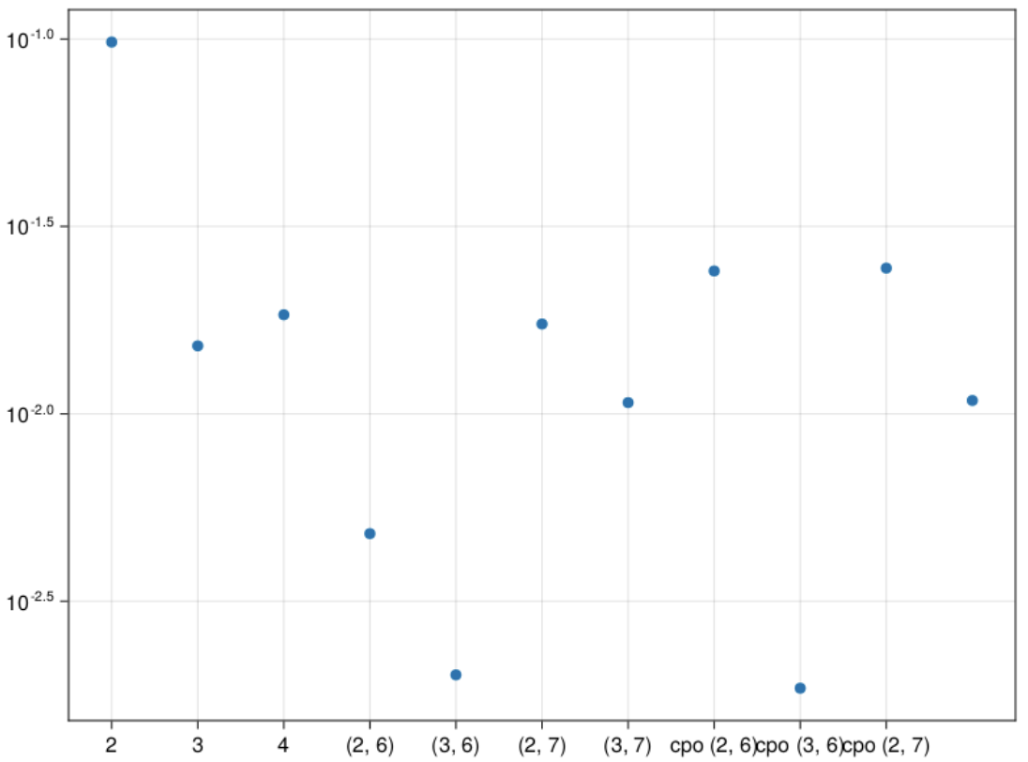
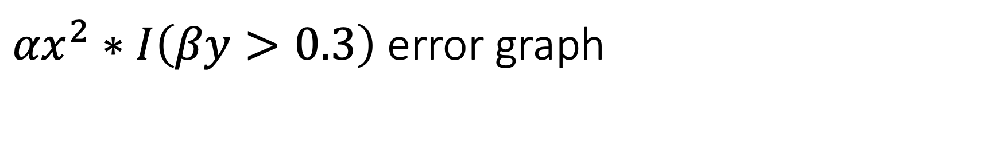
${αx}^{2}∗I\left(βy>0.3\right)$ error graph
2 – 2 stored moments
3 – 3 stored moments
(2,6) – 2 stored, 6 pseudo
(3,6) – 3 stored, 6 pseudo
(2,7) - 2 stored, 7 pseudo
(3,7) – 3 stored, 7 pseudo
cpo(2,6) – max cumulant order 2, order 6
cpo(3,6) – max cumulant order 3, order 6
cpo(2,7) – max cumulant order 3, order 7
cpo(3,7) – max cumulant order 3, order 7

Slide 7
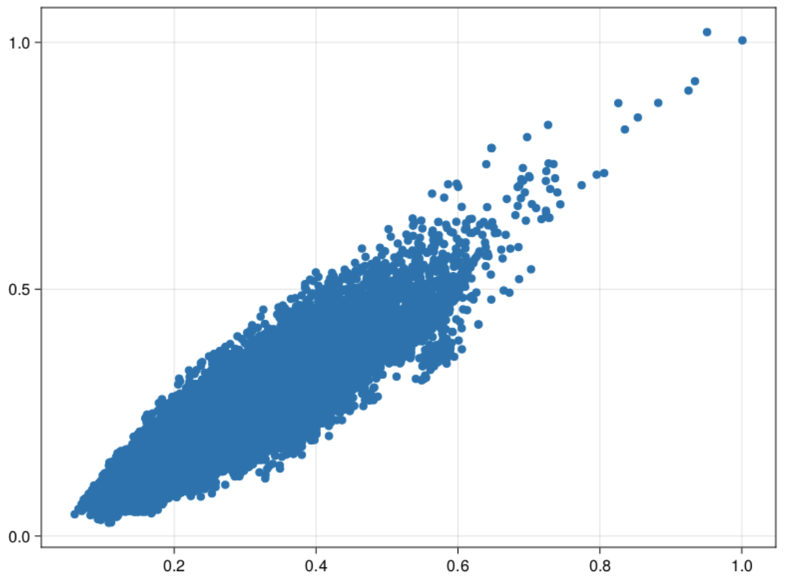
Scatter plot of Data

Slide 8
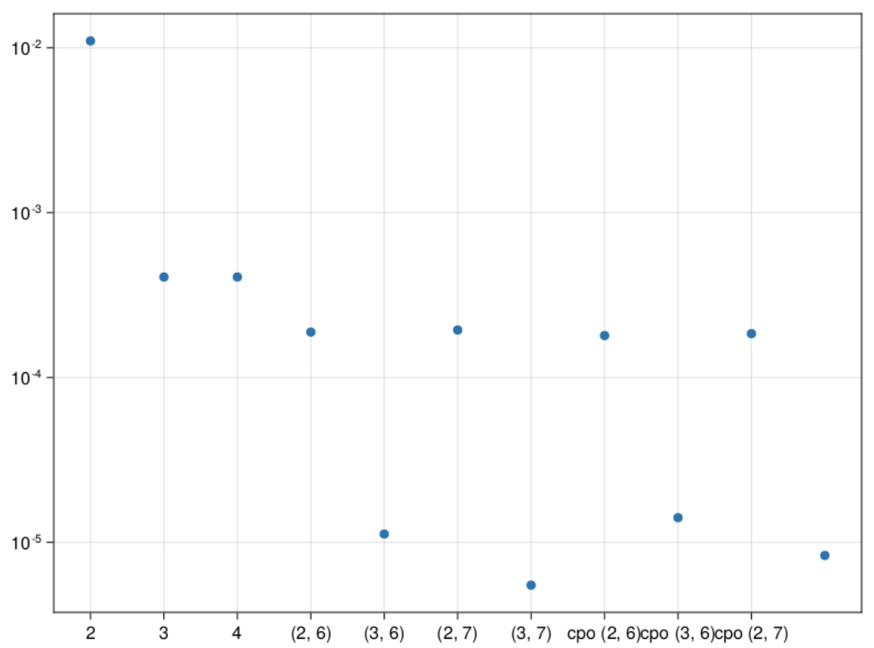
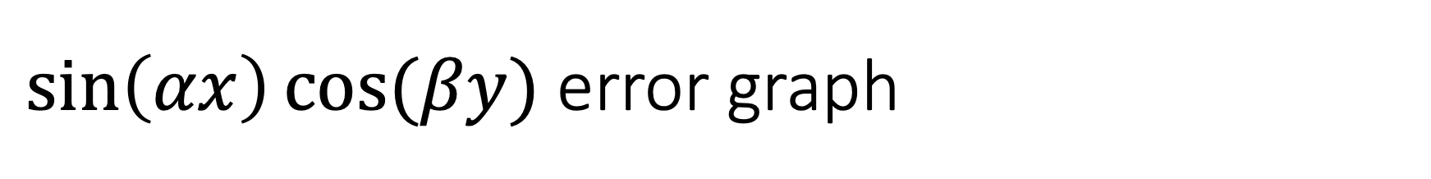
$\sin\left(αx\right)cos⁡(βy)$ error graph
2 – 2 stored moments
3 – 3 stored moments
(2,6) – 2 stored, 6 pseudo
(3,6) – 3 stored, 6 pseudo
(2,7) - 2 stored, 7 pseudo
(3,7) – 3 stored, 7 pseudo
cpo(2,6) – max cumulant order 2, order 6
cpo(3,6) – max cumulant order 3, order 6
cpo(2,7) – max cumulant order 3, order 7
cpo(3,7) – max cumulant order 3, order 7

Slide 9
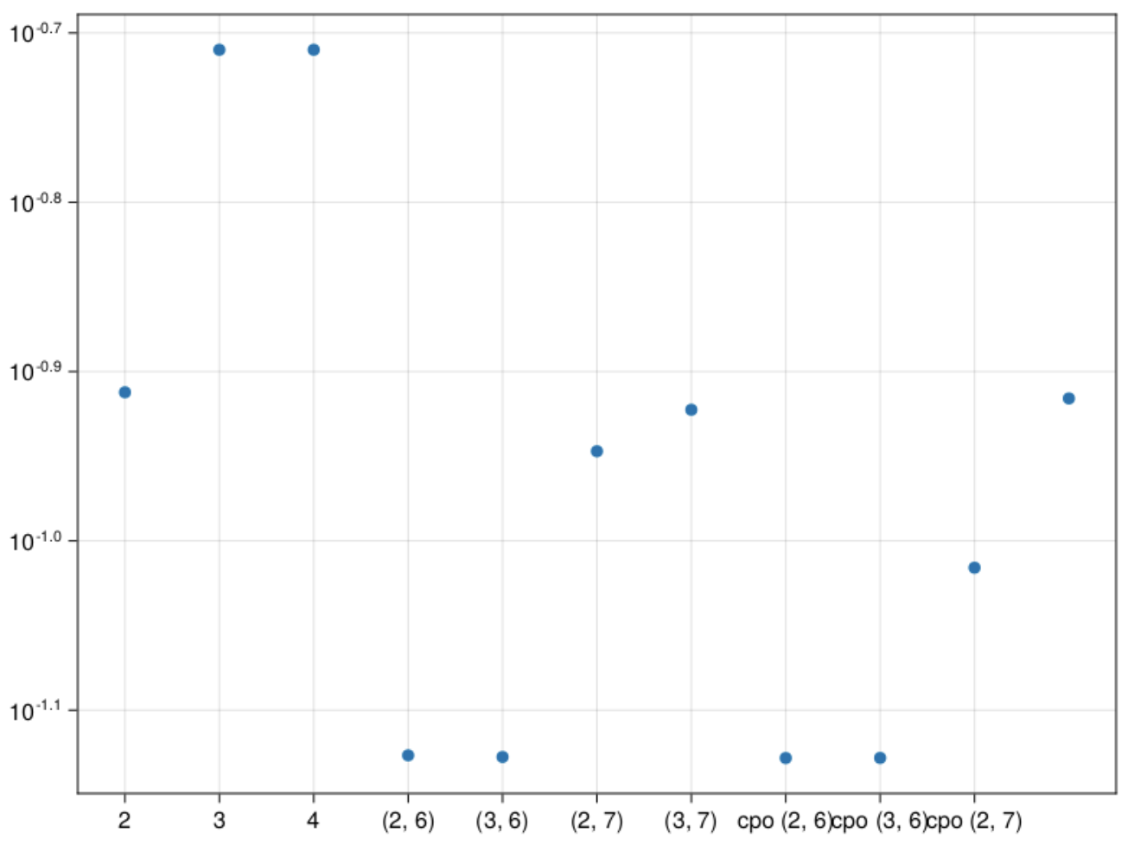
$\tan\left(αx+ βy\right)$ error graph
2 – 2 stored moments
3 – 3 stored moments
(2,6) – 2 stored, 6 pseudo
(3,6) – 3 stored, 6 pseudo
(2,7) - 2 stored, 7 pseudo
(3,7) – 3 stored, 7 pseudo
cpo(2,6) – max cumulant order 2, order 6
cpo(3,6) – max cumulant order 3, order 6
cpo(2,7) – max cumulant order 3, order 7
cpo(3,7) – max cumulant order 3, order 7

Slide 10
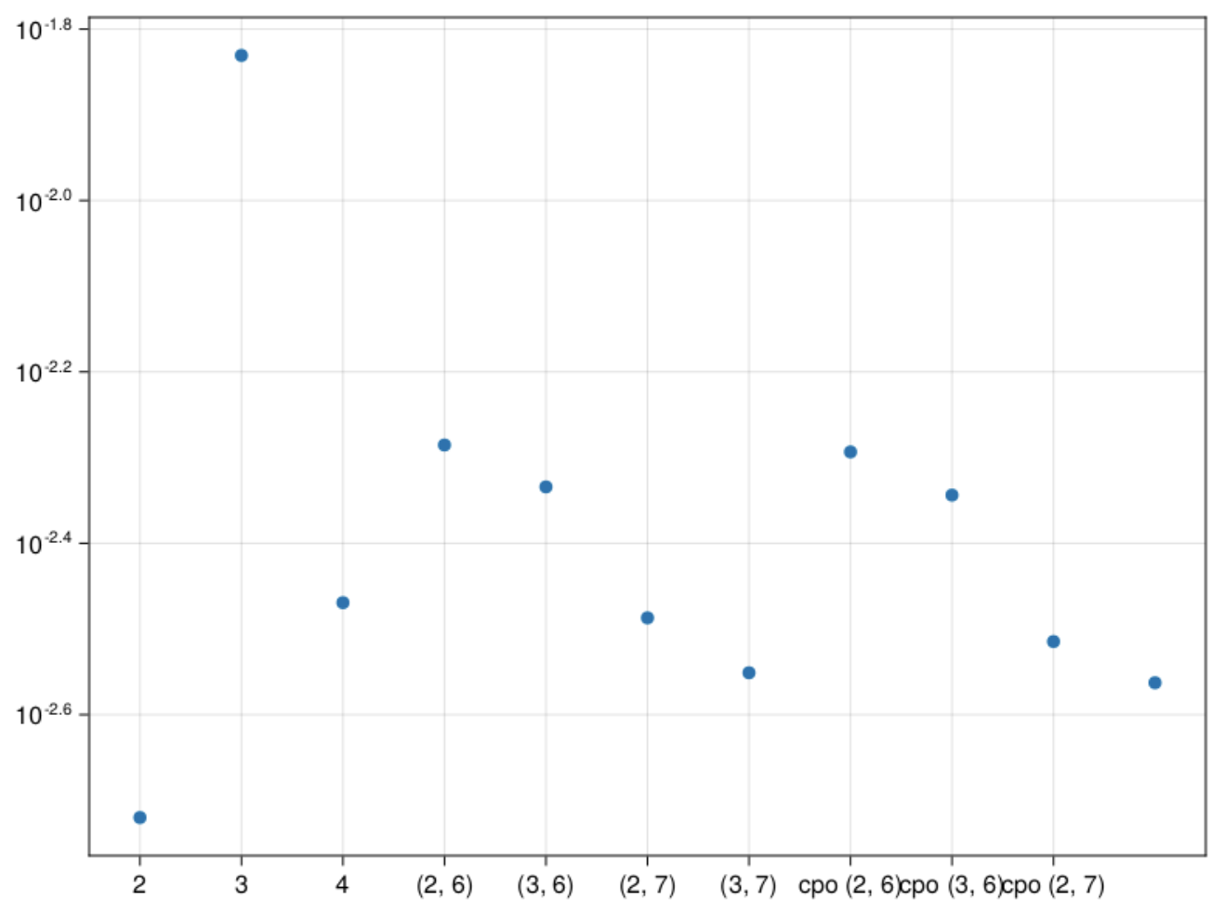
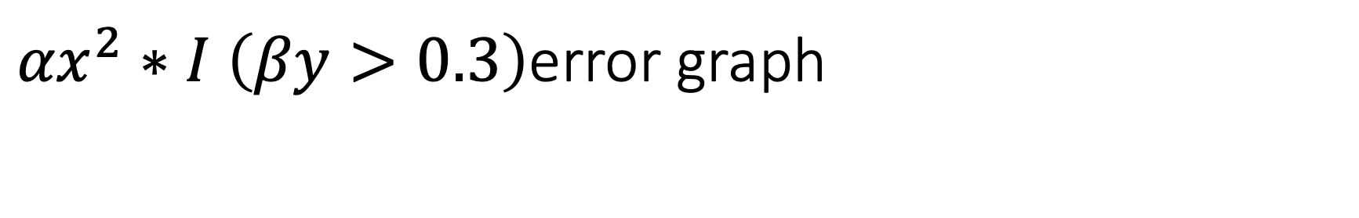
${αx}^{2}∗I$ $\left(βy>0.3\right)$error graph
2 – 2 stored moments
3 – 3 stored moments
(2,6) – 2 stored, 6 pseudo
(3,6) – 3 stored, 6 pseudo
(2,7) - 2 stored, 7 pseudo
(3,7) – 3 stored, 7 pseudo
cpo(2,6) – max cumulant order 2, order 6
cpo(3,6) – max cumulant order 3, order 6
cpo(2,7) – max cumulant order 3, order 7
cpo(3,7) – max cumulant order 3, order 7

Slide 11
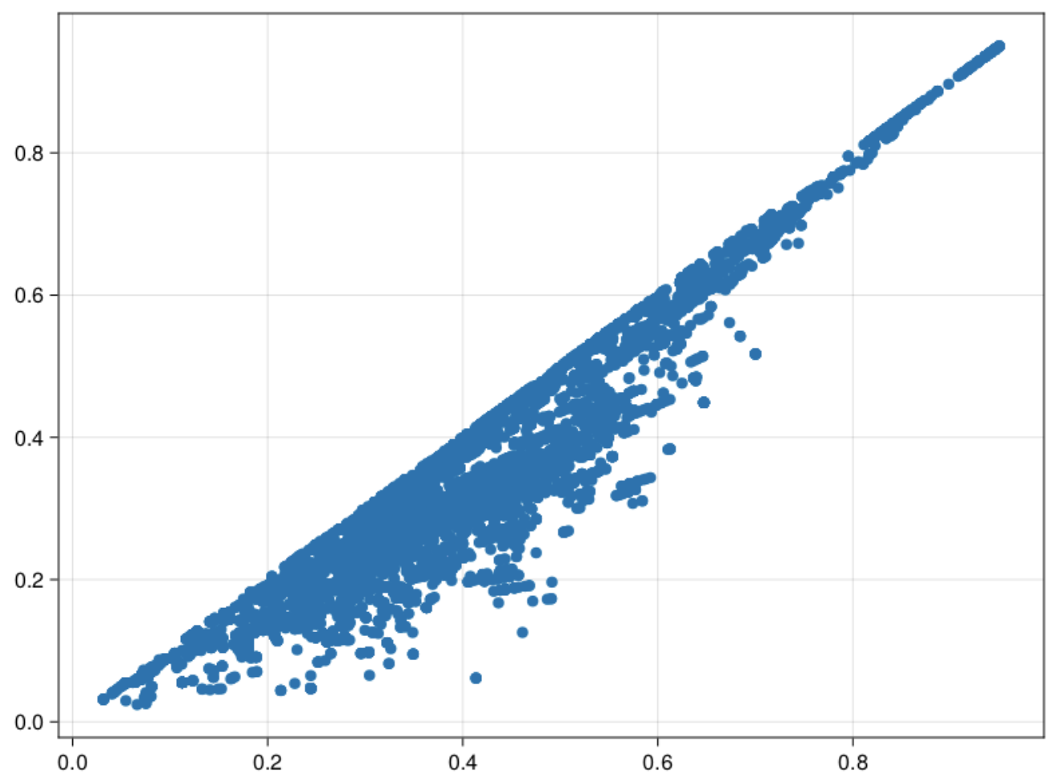
Scatter plot of Data

Slide 12
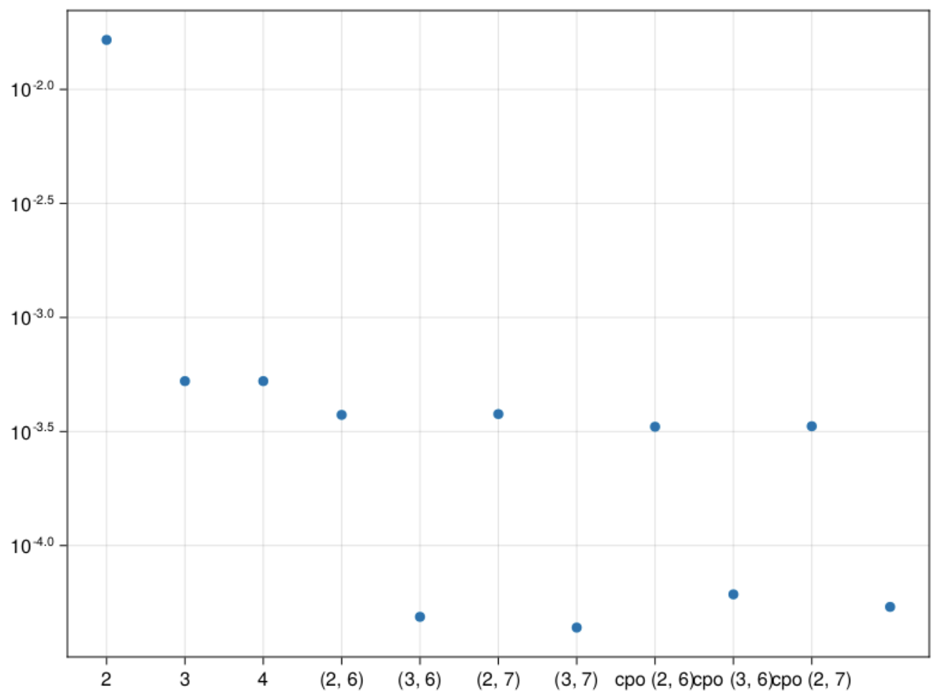
$\sin\left(αx\right)cos⁡(βy)$ error graph
2 – 2 stored moments
3 – 3 stored moments
(2,6) – 2 stored, 6 pseudo
(3,6) – 3 stored, 6 pseudo
(2,7) - 2 stored, 7 pseudo
(3,7) – 3 stored, 7 pseudo
cpo(2,6) – max cumulant order 2, order 6
cpo(3,6) – max cumulant order 3, order 6
cpo(2,7) – max cumulant order 3, order 7
cpo(3,7) – max cumulant order 3, order 7

Slide 13
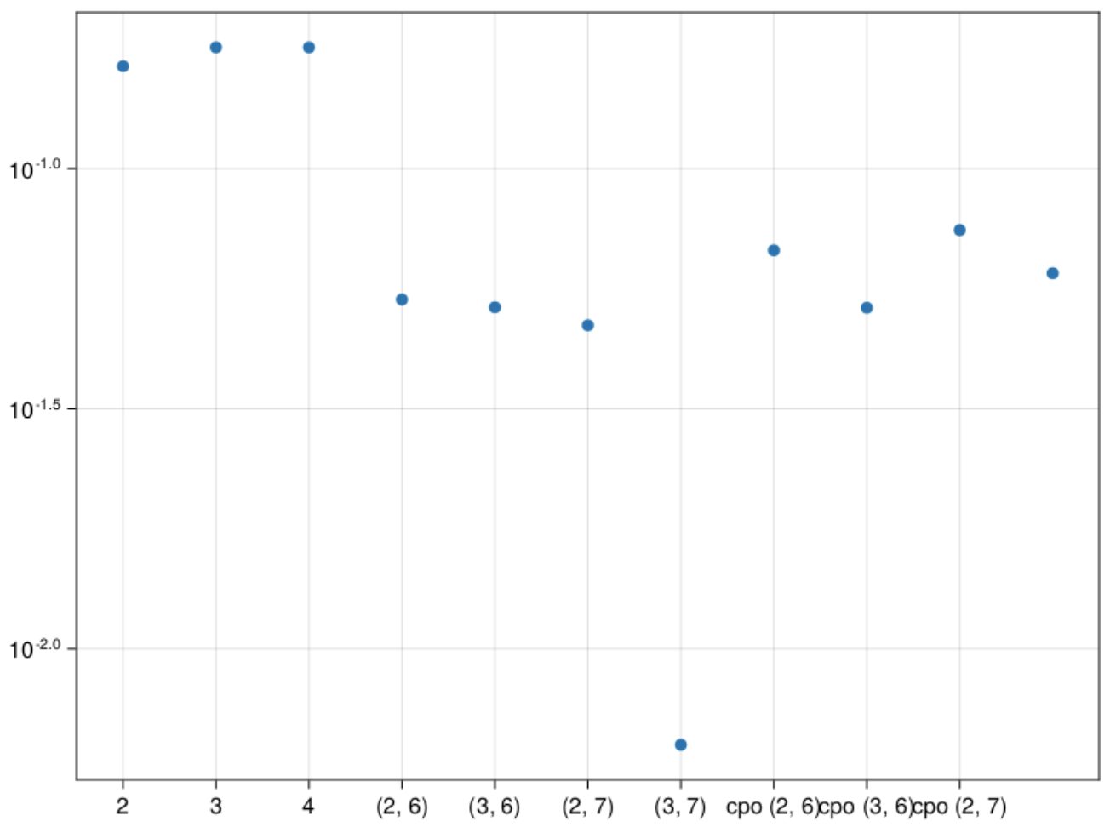
$\tan\left(αx+ βy\right)$ error graph
2 – 2 stored moments
3 – 3 stored moments
(2,6) – 2 stored, 6 pseudo
(3,6) – 3 stored, 6 pseudo
(2,7) - 2 stored, 7 pseudo
(3,7) – 3 stored, 7 pseudo
cpo(2,6) – max cumulant order 2, order 6
cpo(3,6) – max cumulant order 3, order 6
cpo(2,7) – max cumulant order 3, order 7
cpo(3,7) – max cumulant order 3, order 7

Slide 14
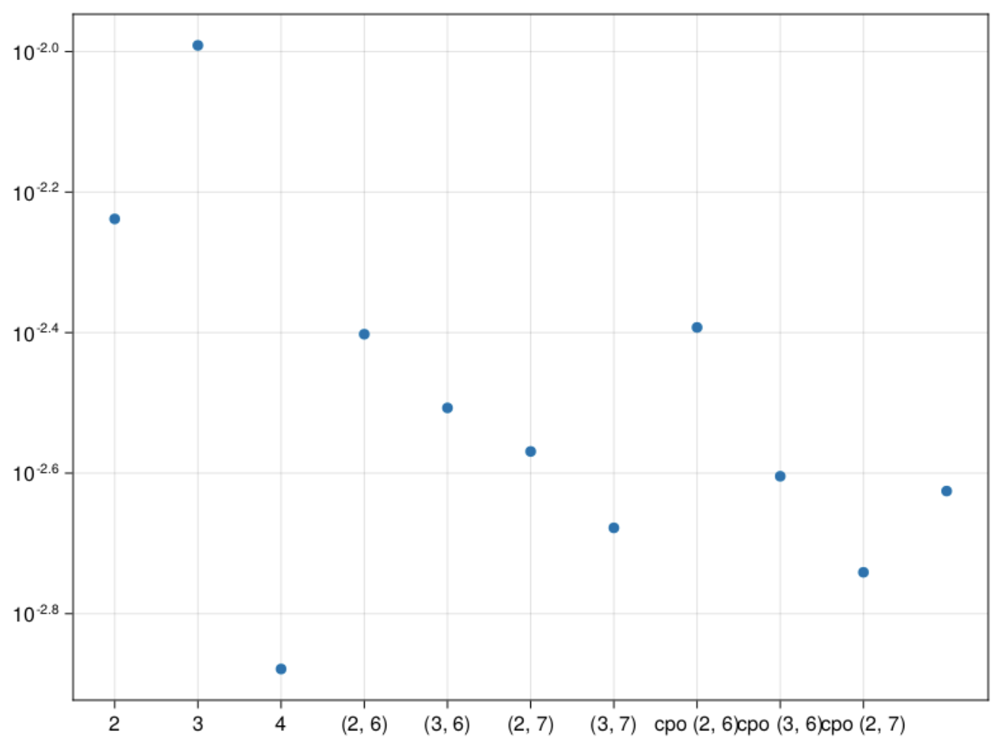
${αx}^{2}∗I\left(βy>0.3\right)$ error graph
2 – 2 stored moments
3 – 3 stored moments
(2,6) – 2 stored, 6 pseudo
(3,6) – 3 stored, 6 pseudo
(2,7) - 2 stored, 7 pseudo
(3,7) – 3 stored, 7 pseudo
cpo(2,6) – max cumulant order 2, order 6
cpo(3,6) – max cumulant order 3, order 6
cpo(2,7) – max cumulant order 3, order 7
cpo(3,7) – max cumulant order 3, order 7

Slide 15
Synthetic Data
X and Y are drawn from a skewed normal distribution
Z1 is a function dependent on X and Y
Z2 is a different function dependent on X and Y
x-axis is Z1, y-axis is Z2

Slide 16
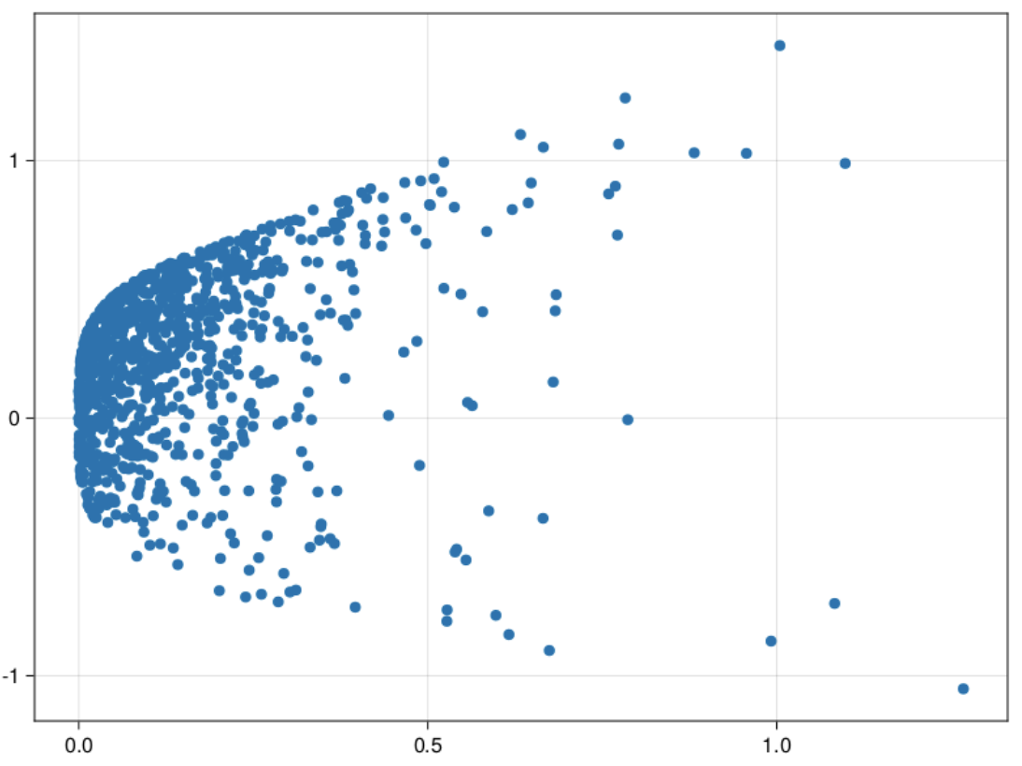
Scatter plot of Data
Z1 function – x^2 + y^4
Z2 function – x^2 + y
Skewness – (-4)

Slide 17
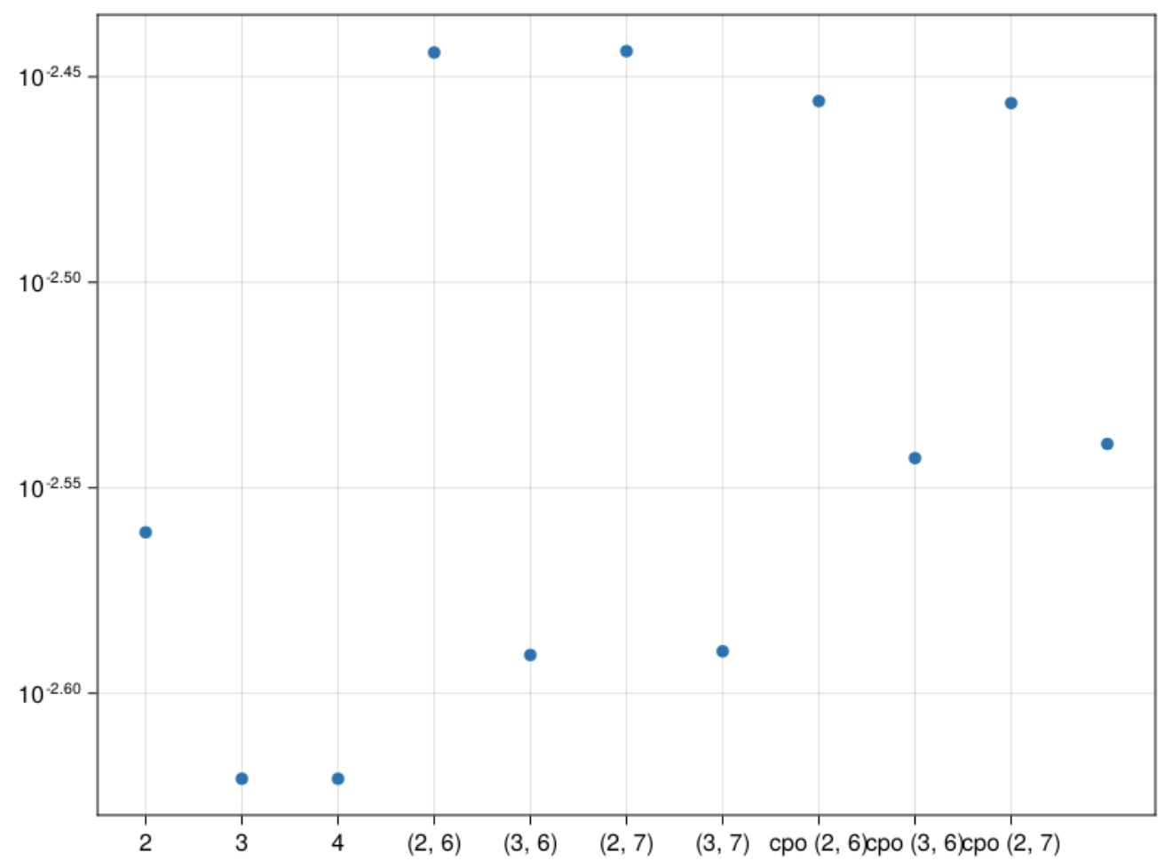
$\sin\left(αx\right)cos⁡(βy)$ error graph
2 – 2 stored moments
3 – 3 stored moments
(2,6) – 2 stored, 6 pseudo
(3,6) – 3 stored, 6 pseudo
(2,7) - 2 stored, 7 pseudo
(3,7) – 3 stored, 7 pseudo
cpo(2,6) – max cumulant order 2, order 6
cpo(3,6) – max cumulant order 3, order 6
cpo(2,7) – max cumulant order 3, order 7
cpo(3,7) – max cumulant order 3, order 7

Slide 18
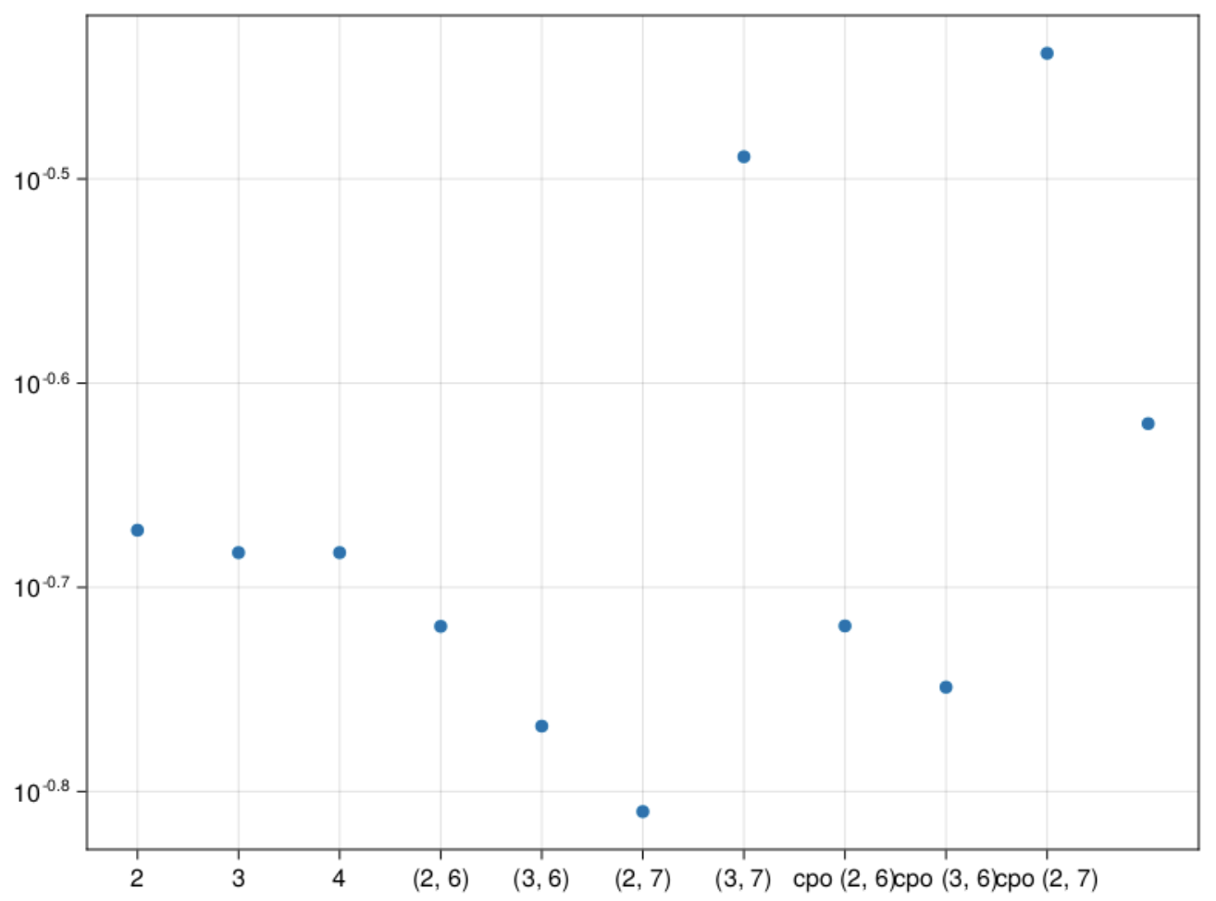
$\tan\left(αx+ βy\right)$ error graph
2 – 2 stored moments
3 – 3 stored moments
(2,6) – 2 stored, 6 pseudo
(3,6) – 3 stored, 6 pseudo
(2,7) - 2 stored, 7 pseudo
(3,7) – 3 stored, 7 pseudo
cpo(2,6) – max cumulant order 2, order 6
cpo(3,6) – max cumulant order 3, order 6
cpo(2,7) – max cumulant order 3, order 7
cpo(3,7) – max cumulant order 3, order 7

Slide 19
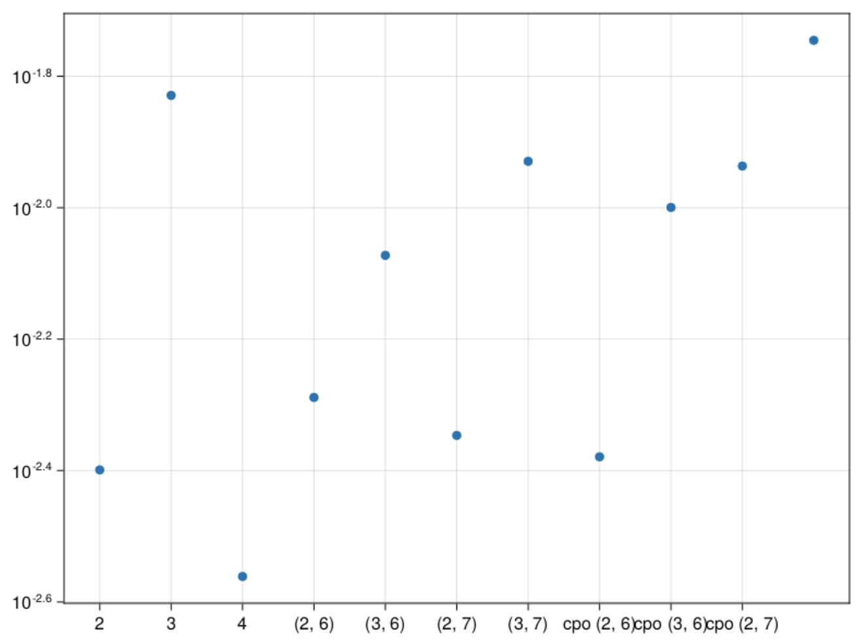
${αx}^{2}∗I\left(βy>0.3\right)$ error graph
2 – 2 stored moments
3 – 3 stored moments
(2,6) – 2 stored, 6 pseudo
(3,6) – 3 stored, 6 pseudo
(2,7) - 2 stored, 7 pseudo
(3,7) – 3 stored, 7 pseudo
cpo(2,6) – max cumulant order 2, order 6
cpo(3,6) – max cumulant order 3, order 6
cpo(2,7) – max cumulant order 3, order 7
cpo(3,7) – max cumulant order 3, order 7

Slide 20
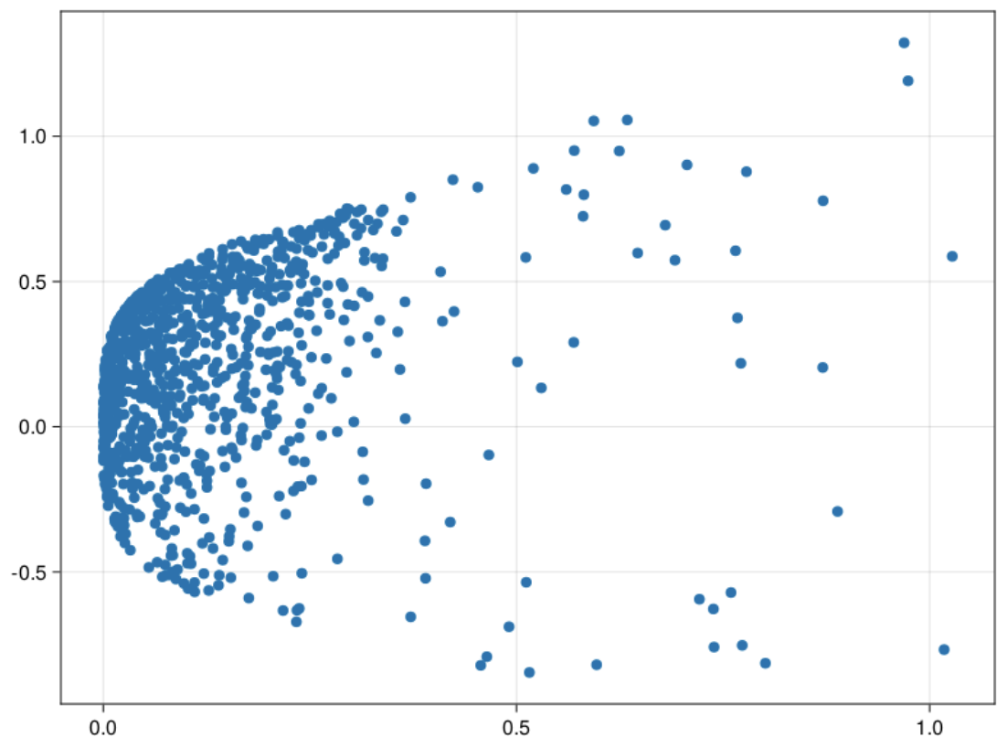
Scatter plot of Data
Z1 function – x^2 + y^4
Z2 function – x^2 + y
Skewness – (-8)

Slide 21
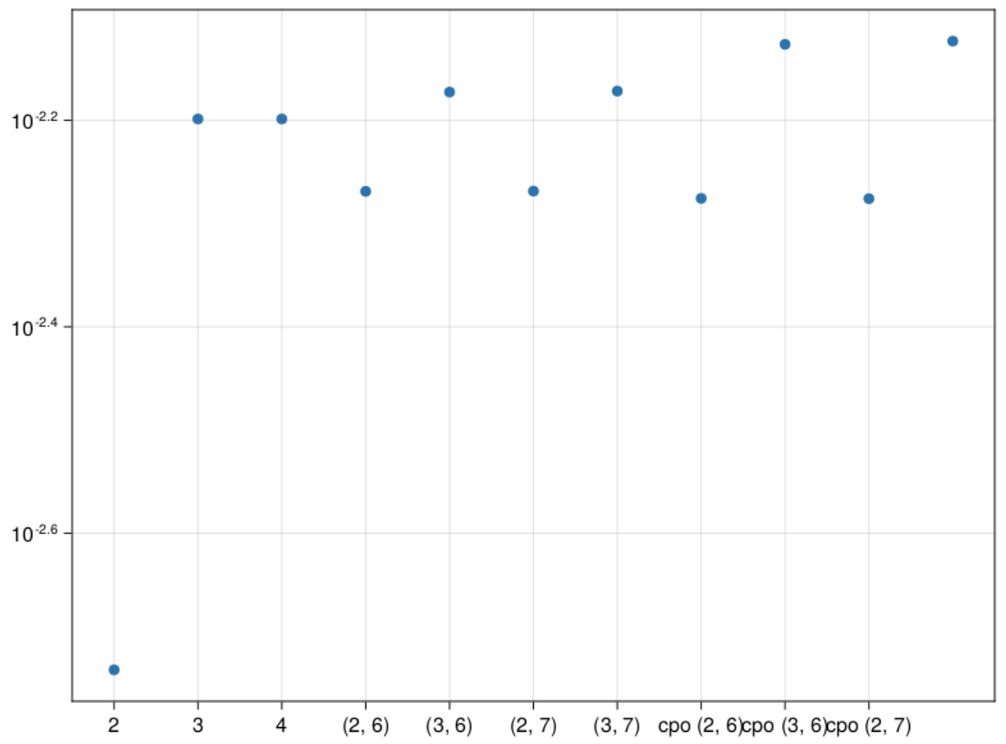
$\sin\left(αx\right)cos⁡(βy)$ error graph
2 – 2 stored moments
3 – 3 stored moments
(2,6) – 2 stored, 6 pseudo
(3,6) – 3 stored, 6 pseudo
(2,7) - 2 stored, 7 pseudo
(3,7) – 3 stored, 7 pseudo
cpo(2,6) – max cumulant order 2, order 6
cpo(3,6) – max cumulant order 3, order 6
cpo(2,7) – max cumulant order 3, order 7
cpo(3,7) – max cumulant order 3, order 7

Slide 22
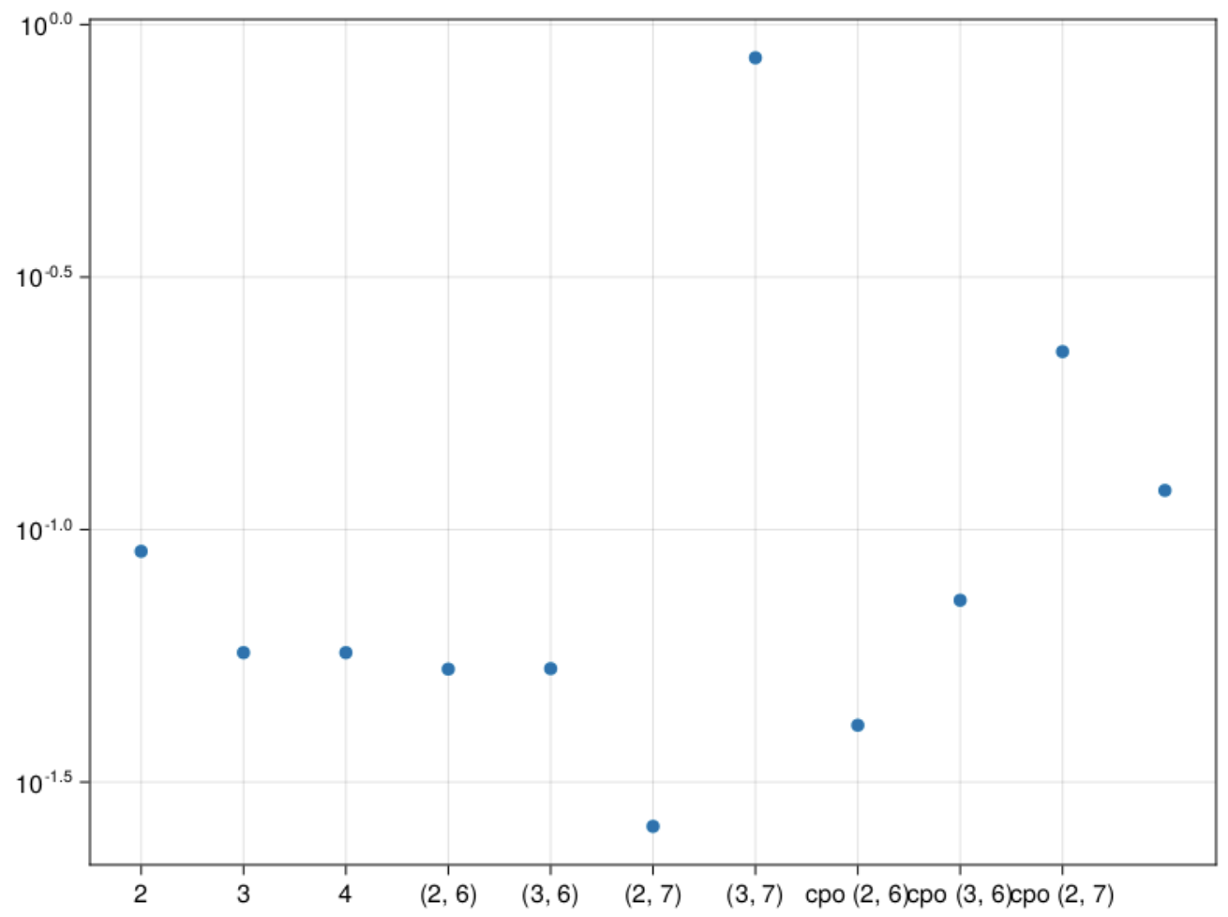
$\tan\left(αx+ βy\right)$ error graph
2 – 2 stored moments
3 – 3 stored moments
(2,6) – 2 stored, 6 pseudo
(3,6) – 3 stored, 6 pseudo
(2,7) - 2 stored, 7 pseudo
(3,7) – 3 stored, 7 pseudo
cpo(2,6) – max cumulant order 2, order 6
cpo(3,6) – max cumulant order 3, order 6
cpo(2,7) – max cumulant order 3, order 7
cpo(3,7) – max cumulant order 3, order 7

Slide 23
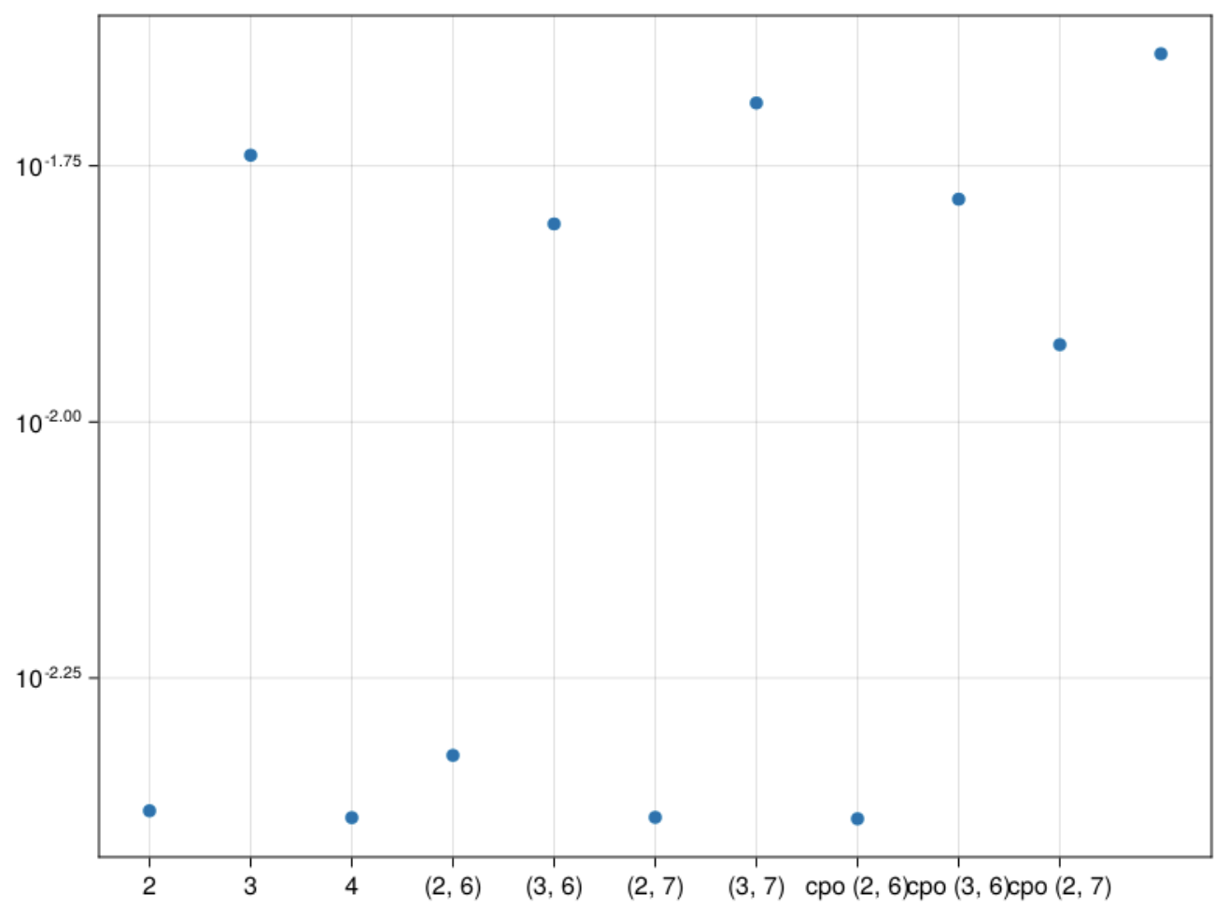
${αx}^{2}∗I\left(βy>0.3\right)$ error graph
2 – 2 stored moments
3 – 3 stored moments
(2,6) – 2 stored, 6 pseudo
(3,6) – 3 stored, 6 pseudo
(2,7) - 2 stored, 7 pseudo
(3,7) – 3 stored, 7 pseudo
cpo(2,6) – max cumulant order 2, order 6
cpo(3,6) – max cumulant order 3, order 6
cpo(2,7) – max cumulant order 3, order 7
cpo(3,7) – max cumulant order 3, order 7

Slide 24
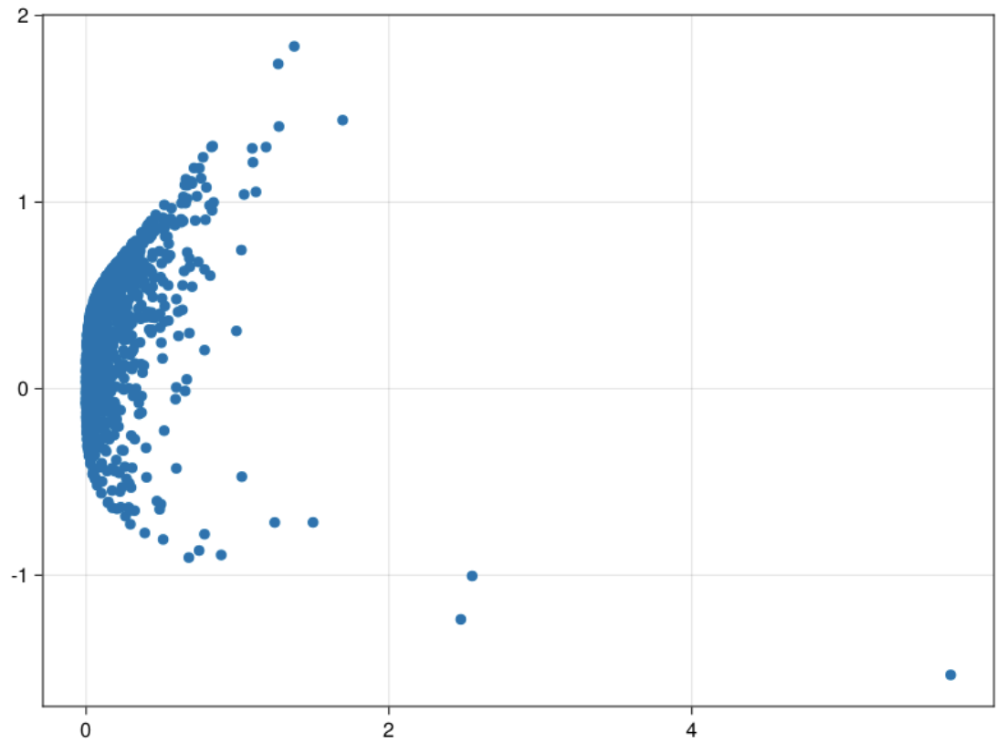
Scatter plot of Data
Z1 function – x^2 + y^4
Z2 function – x^2 + y
Skewness – (-2)

Slide 25
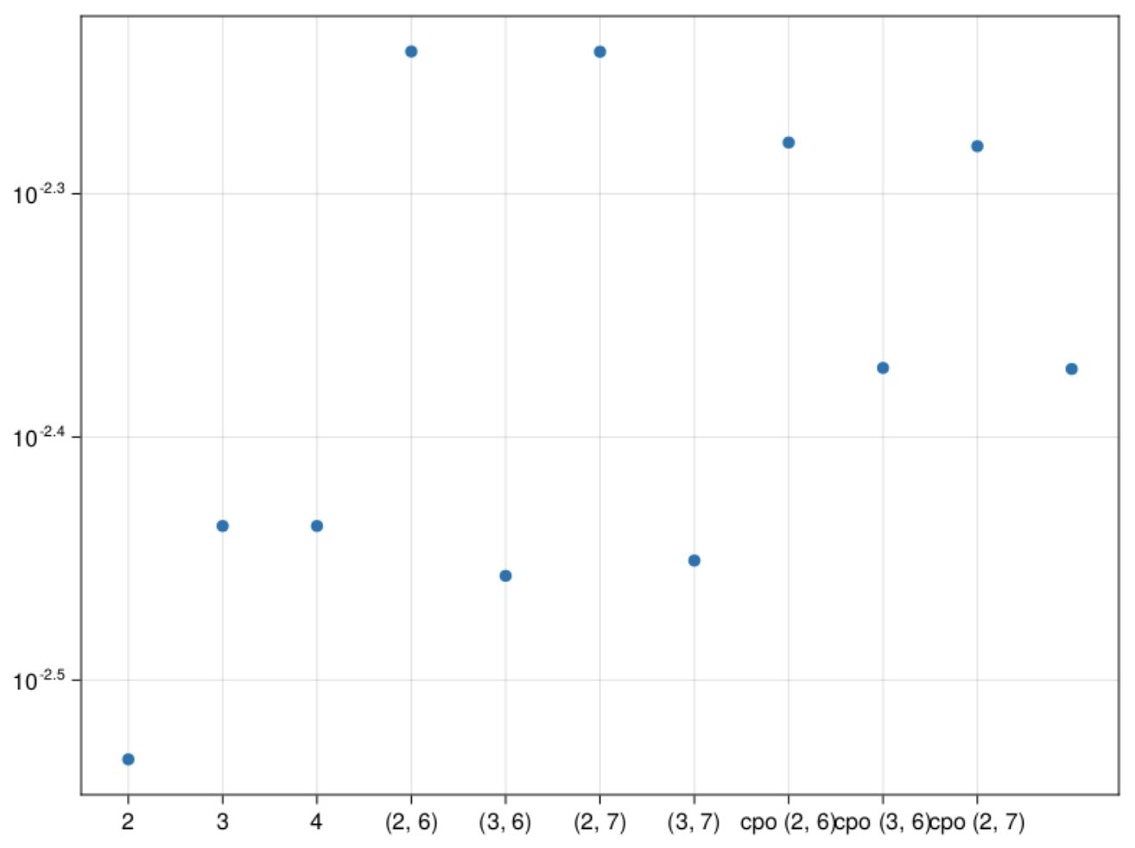
$\sin\left(αx\right)cos⁡(βy)$ error graph
2 – 2 stored moments
3 – 3 stored moments
(2,6) – 2 stored, 6 pseudo
(3,6) – 3 stored, 6 pseudo
(2,7) - 2 stored, 7 pseudo
(3,7) – 3 stored, 7 pseudo
cpo(2,6) – max cumulant order 2, order 6
cpo(3,6) – max cumulant order 3, order 6
cpo(2,7) – max cumulant order 3, order 7
cpo(3,7) – max cumulant order 3, order 7

Slide 26
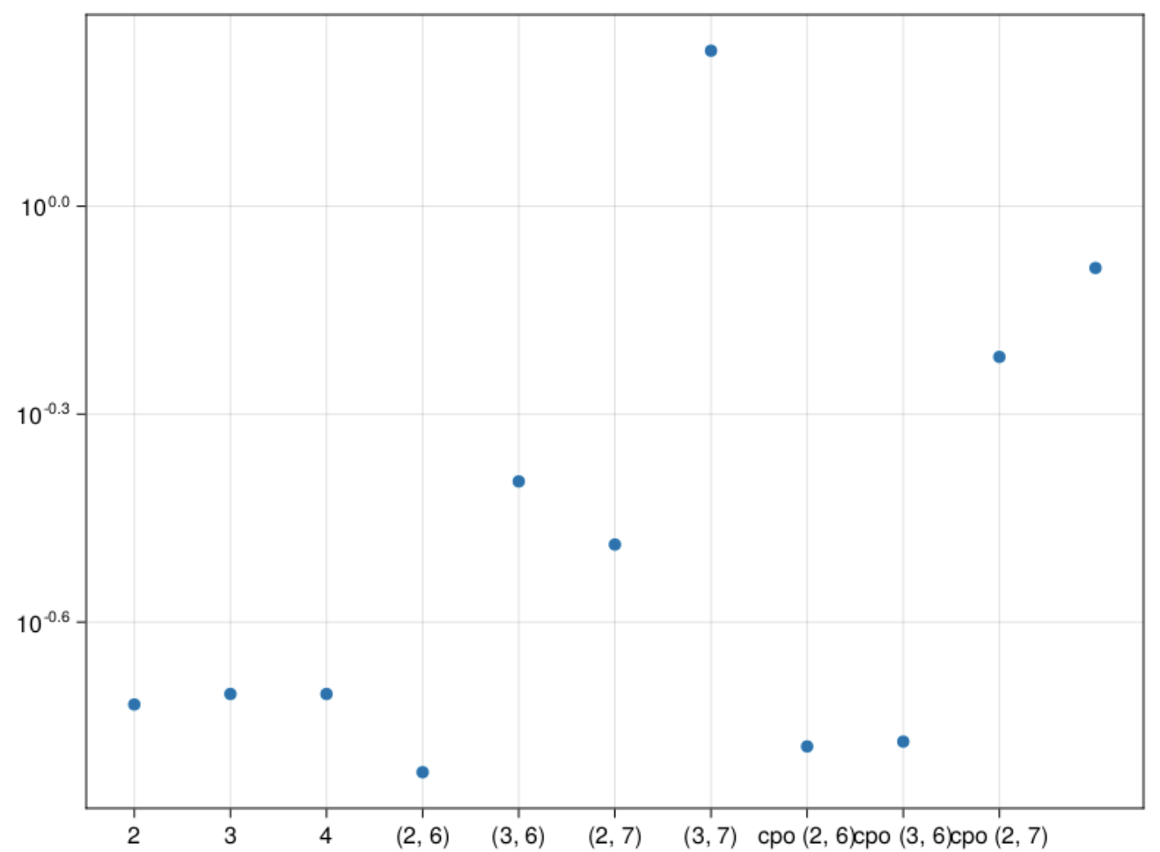
$\tan\left(αx+ βy\right)$ error graph
2 – 2 stored moments
3 – 3 stored moments
(2,6) – 2 stored, 6 pseudo
(3,6) – 3 stored, 6 pseudo
(2,7) - 2 stored, 7 pseudo
(3,7) – 3 stored, 7 pseudo
cpo(2,6) – max cumulant order 2, order 6
cpo(3,6) – max cumulant order 3, order 6
cpo(2,7) – max cumulant order 3, order 7
cpo(3,7) – max cumulant order 3, order 7

Slide 27
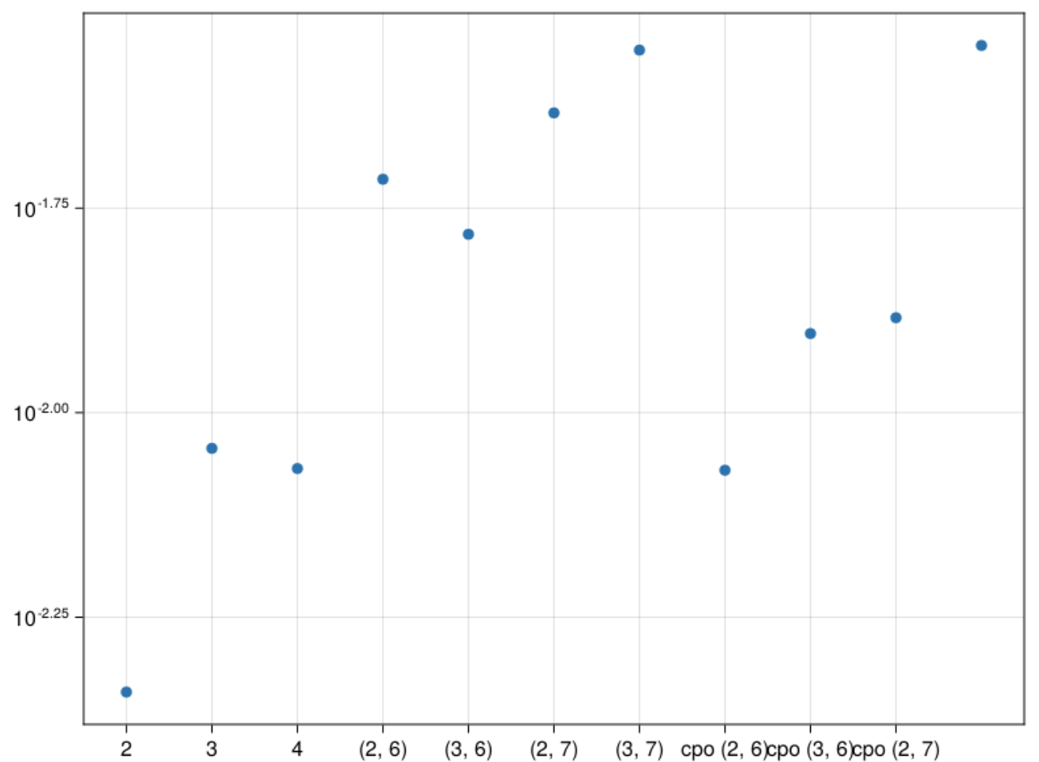
${αx}^{2}∗I\left(βy>0.3\right)$ error graph
2 – 2 stored moments
3 – 3 stored moments
(2,6) – 2 stored, 6 pseudo
(3,6) – 3 stored, 6 pseudo
(2,7) - 2 stored, 7 pseudo
(3,7) – 3 stored, 7 pseudo
cpo(2,6) – max cumulant order 2, order 6
cpo(3,6) – max cumulant order 3, order 6
cpo(2,7) – max cumulant order 3, order 7
cpo(3,7) – max cumulant order 3, order 7

Slide 28
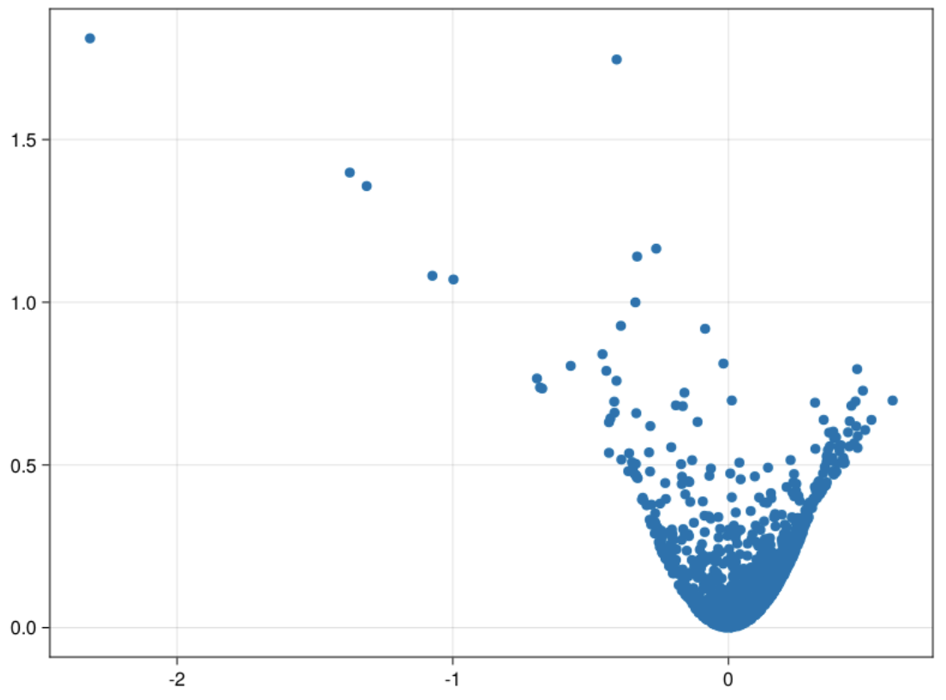
Scatter plot of Data
Z1 function – 0.5x + y^3
Z2 function – x^2 + y^2
Skewness – (-4)

Slide 29
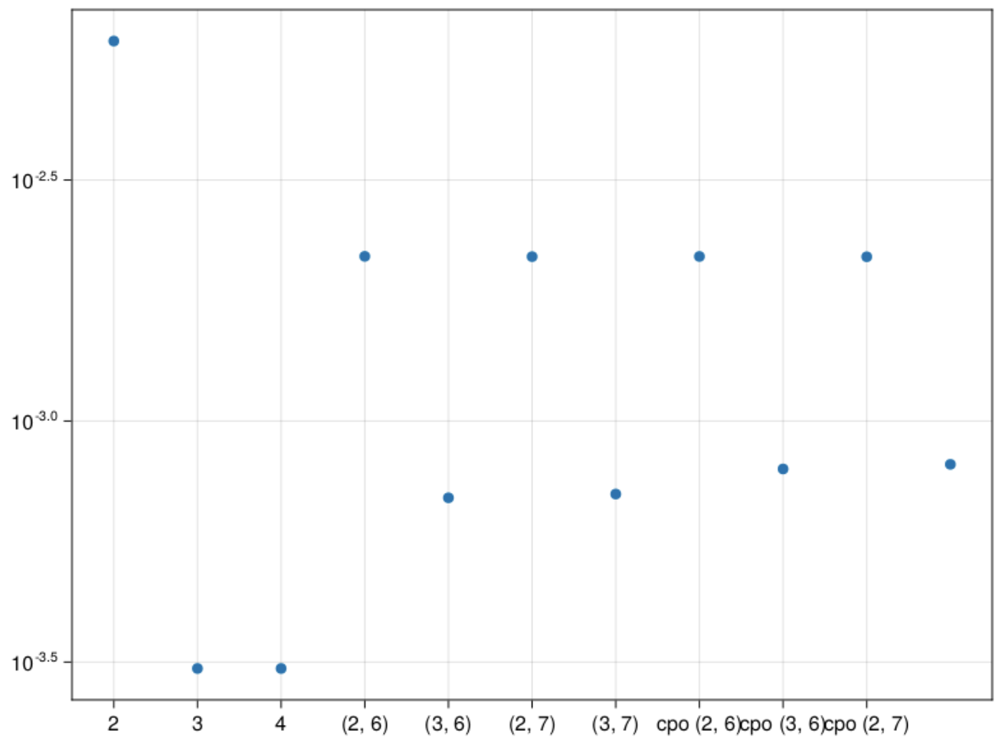
$\sin\left(αx\right)cos⁡(βy)$ error graph
2 – 2 stored moments
3 – 3 stored moments
(2,6) – 2 stored, 6 pseudo
(3,6) – 3 stored, 6 pseudo
(2,7) - 2 stored, 7 pseudo
(3,7) – 3 stored, 7 pseudo
cpo(2,6) – max cumulant order 2, order 6
cpo(3,6) – max cumulant order 3, order 6
cpo(2,7) – max cumulant order 3, order 7
cpo(3,7) – max cumulant order 3, order 7

Slide 30
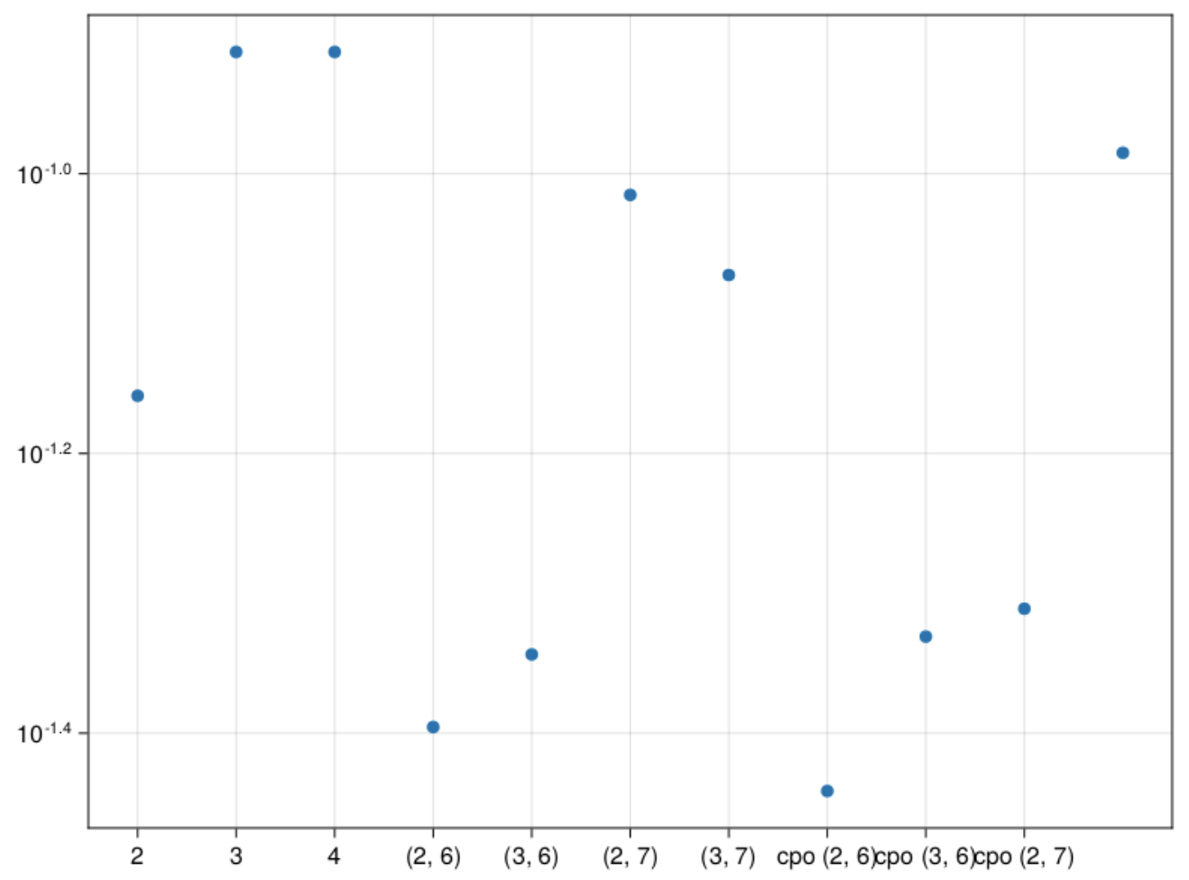
$\tan\left(αx+ βy\right)$ error graph
2 – 2 stored moments
3 – 3 stored moments
(2,6) – 2 stored, 6 pseudo
(3,6) – 3 stored, 6 pseudo
(2,7) - 2 stored, 7 pseudo
(3,7) – 3 stored, 7 pseudo
cpo(2,6) – max cumulant order 2, order 6
cpo(3,6) – max cumulant order 3, order 6
cpo(2,7) – max cumulant order 3, order 7
cpo(3,7) – max cumulant order 3, order 7

Slide 31
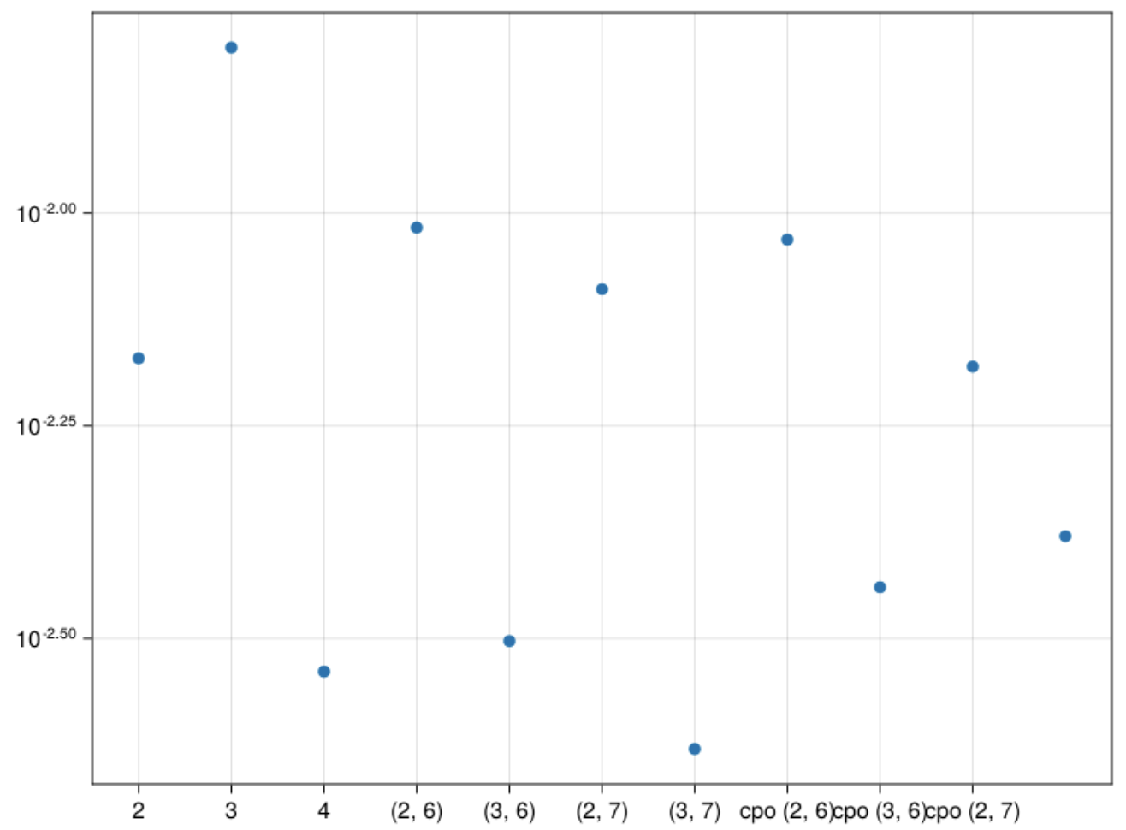
${αx}^{2}∗I\left(βy>0.3\right)$ error graph
2 – 2 stored moments
3 – 3 stored moments
(2,6) – 2 stored, 6 pseudo
(3,6) – 3 stored, 6 pseudo
(2,7) - 2 stored, 7 pseudo
(3,7) – 3 stored, 7 pseudo
cpo(2,6) – max cumulant order 2, order 6
cpo(3,6) – max cumulant order 3, order 6
cpo(2,7) – max cumulant order 3, order 7
cpo(3,7) – max cumulant order 3, order 7

Slide 32
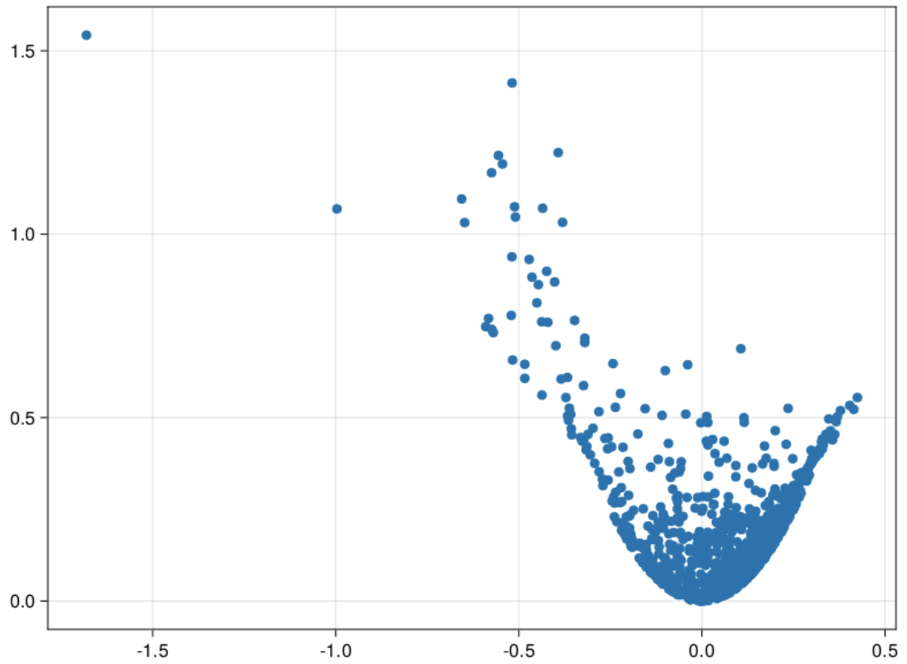
Scatter plot of Data
Z1 function – 0.5x + y^3
Z2 function – x^2 + y^2
Skewness – (-8)

Slide 33
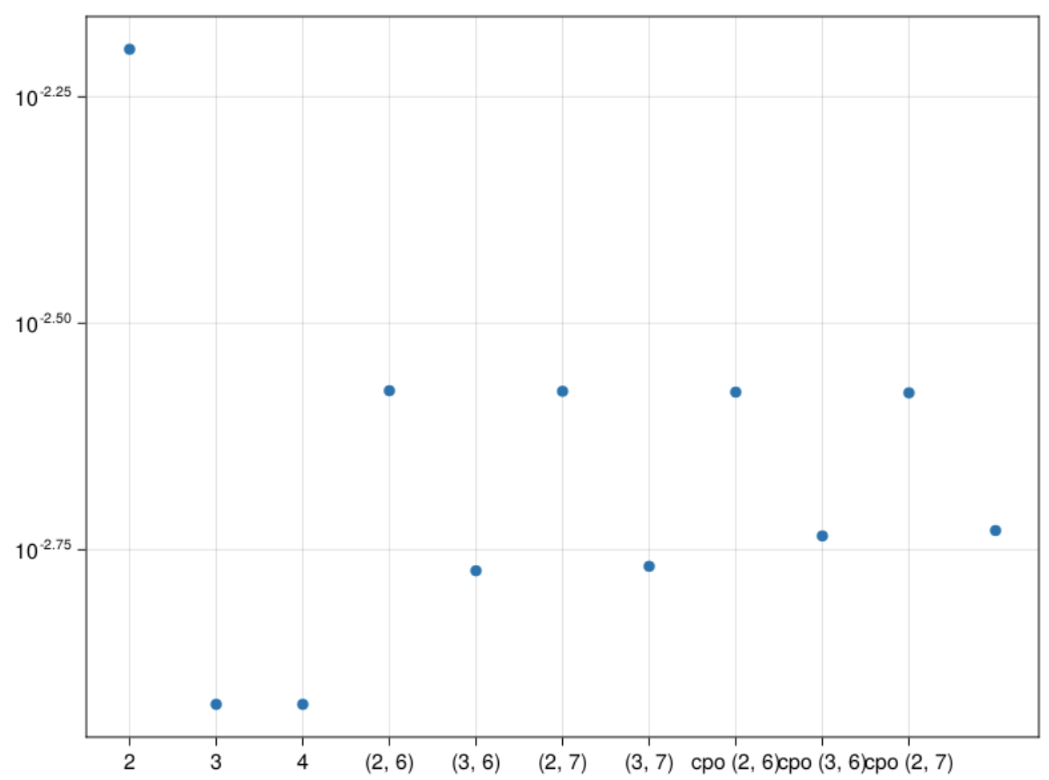
$\sin\left(αx\right)cos⁡(βy)$ error graph
2 – 2 stored moments
3 – 3 stored moments
(2,6) – 2 stored, 6 pseudo
(3,6) – 3 stored, 6 pseudo
(2,7) - 2 stored, 7 pseudo
(3,7) – 3 stored, 7 pseudo
cpo(2,6) – max cumulant order 2, order 6
cpo(3,6) – max cumulant order 3, order 6
cpo(2,7) – max cumulant order 3, order 7
cpo(3,7) – max cumulant order 3, order 7

Slide 34
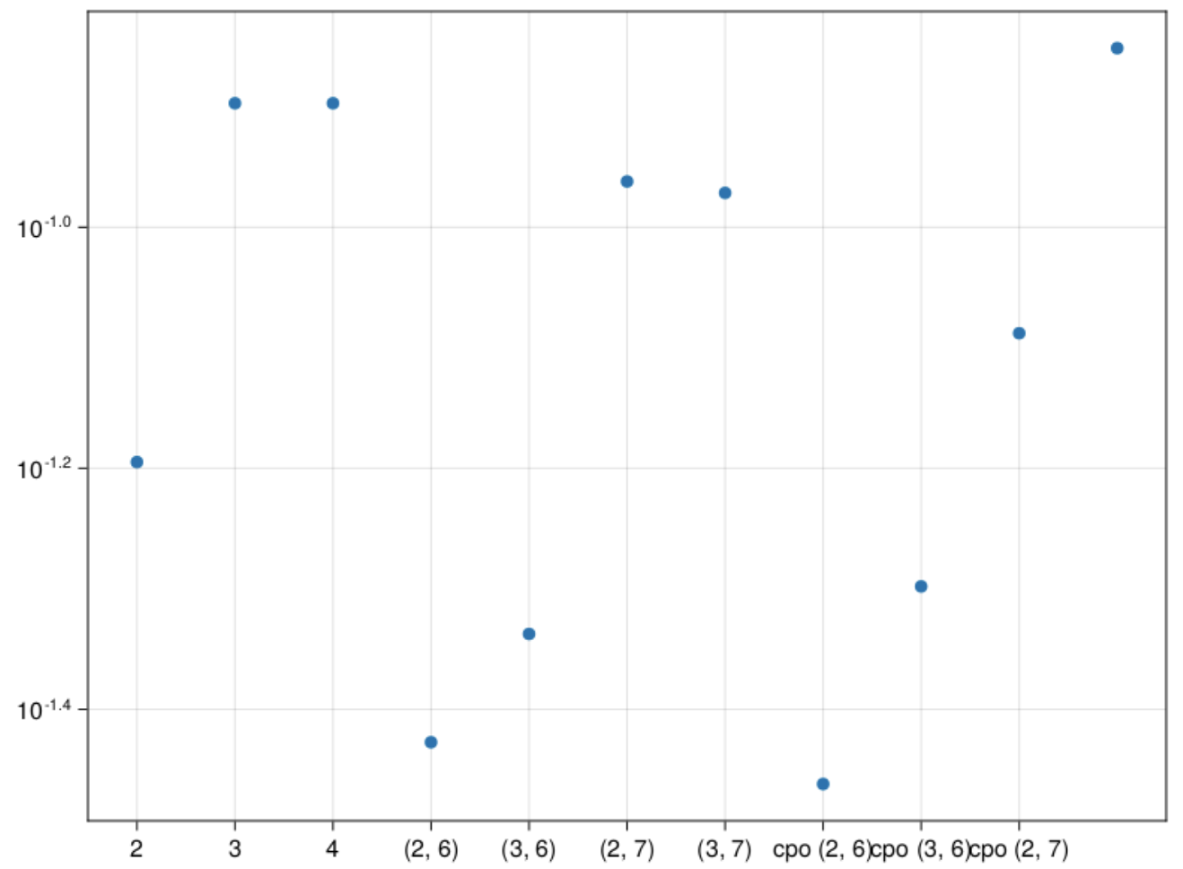
$\tan\left(αx+ βy\right)$ error graph
2 – 2 stored moments
3 – 3 stored moments
(2,6) – 2 stored, 6 pseudo
(3,6) – 3 stored, 6 pseudo
(2,7) - 2 stored, 7 pseudo
(3,7) – 3 stored, 7 pseudo
cpo(2,6) – max cumulant order 2, order 6
cpo(3,6) – max cumulant order 3, order 6
cpo(2,7) – max cumulant order 3, order 7
cpo(3,7) – max cumulant order 3, order 7

Slide 35
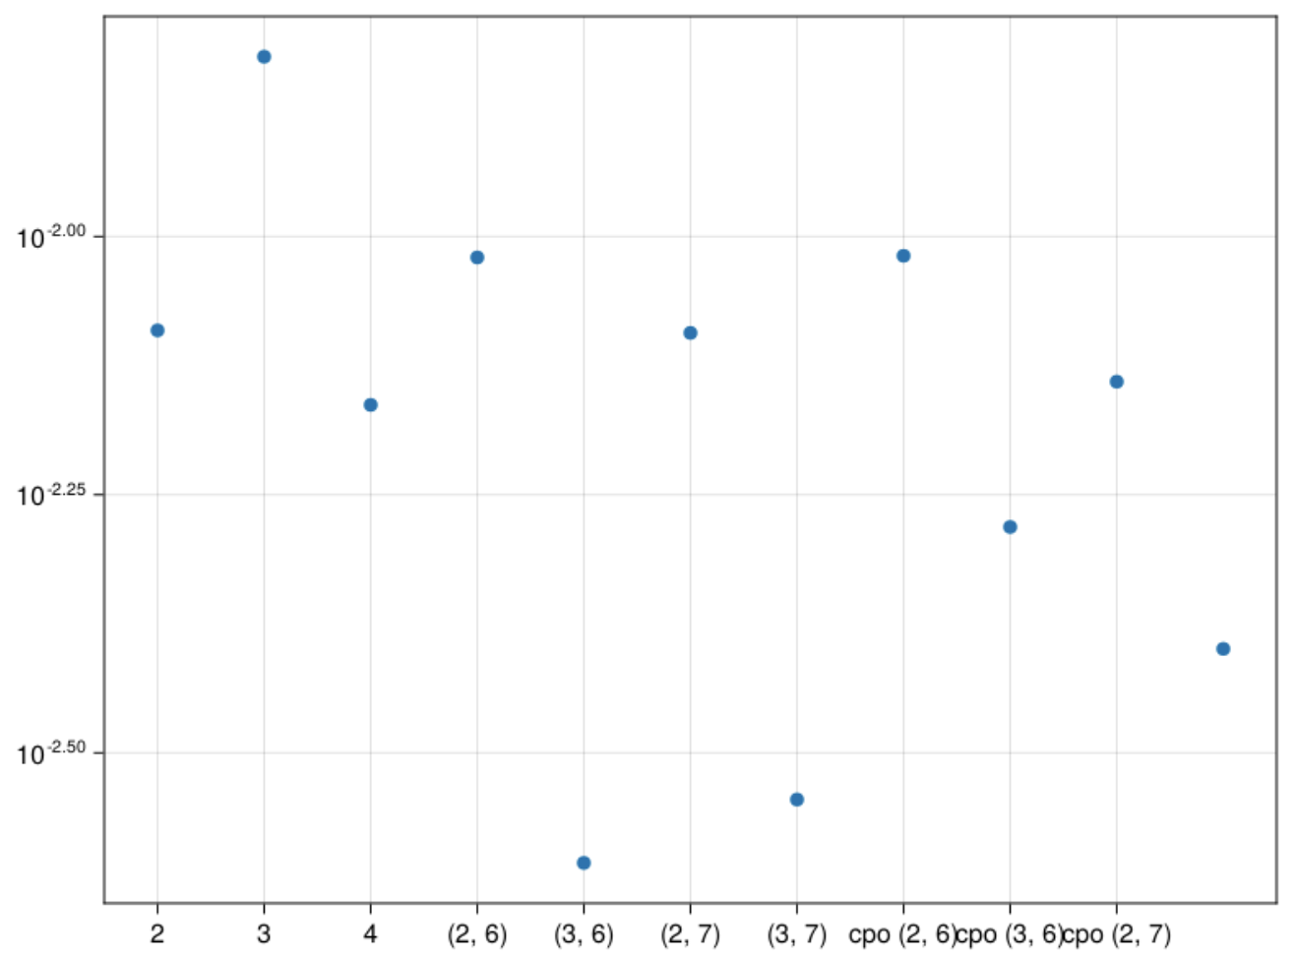
${αx}^{2}∗I\left(βy>0.3\right)$ error graph
2 – 2 stored moments
3 – 3 stored moments
(2,6) – 2 stored, 6 pseudo
(3,6) – 3 stored, 6 pseudo
(2,7) - 2 stored, 7 pseudo
(3,7) – 3 stored, 7 pseudo
cpo(2,6) – max cumulant order 2, order 6
cpo(3,6) – max cumulant order 3, order 6
cpo(2,7) – max cumulant order 3, order 7
cpo(3,7) – max cumulant order 3, order 7

Slide 36
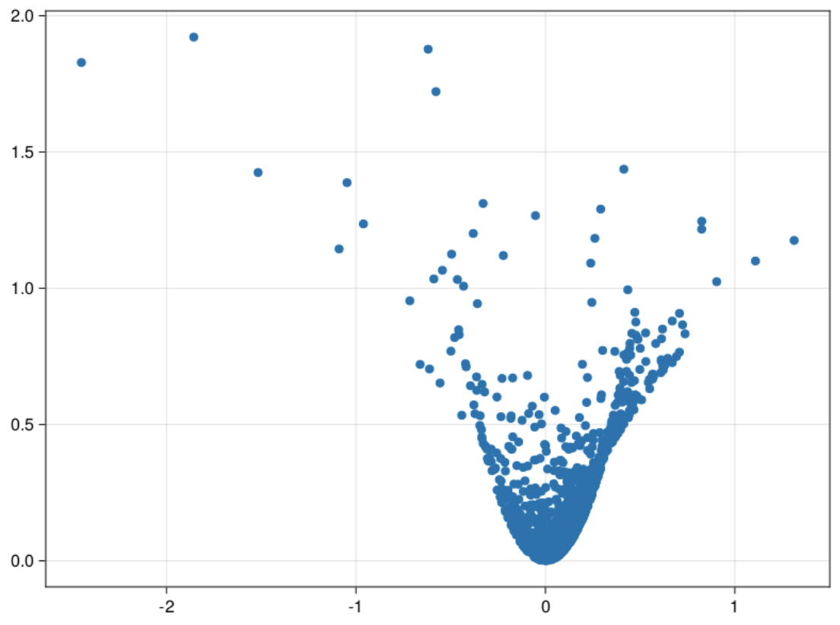
Scatter plot of Data
Z1 function – 0.5x + y^3
Z2 function – x^2 + y^2
Skewness – (-2)

Slide 37
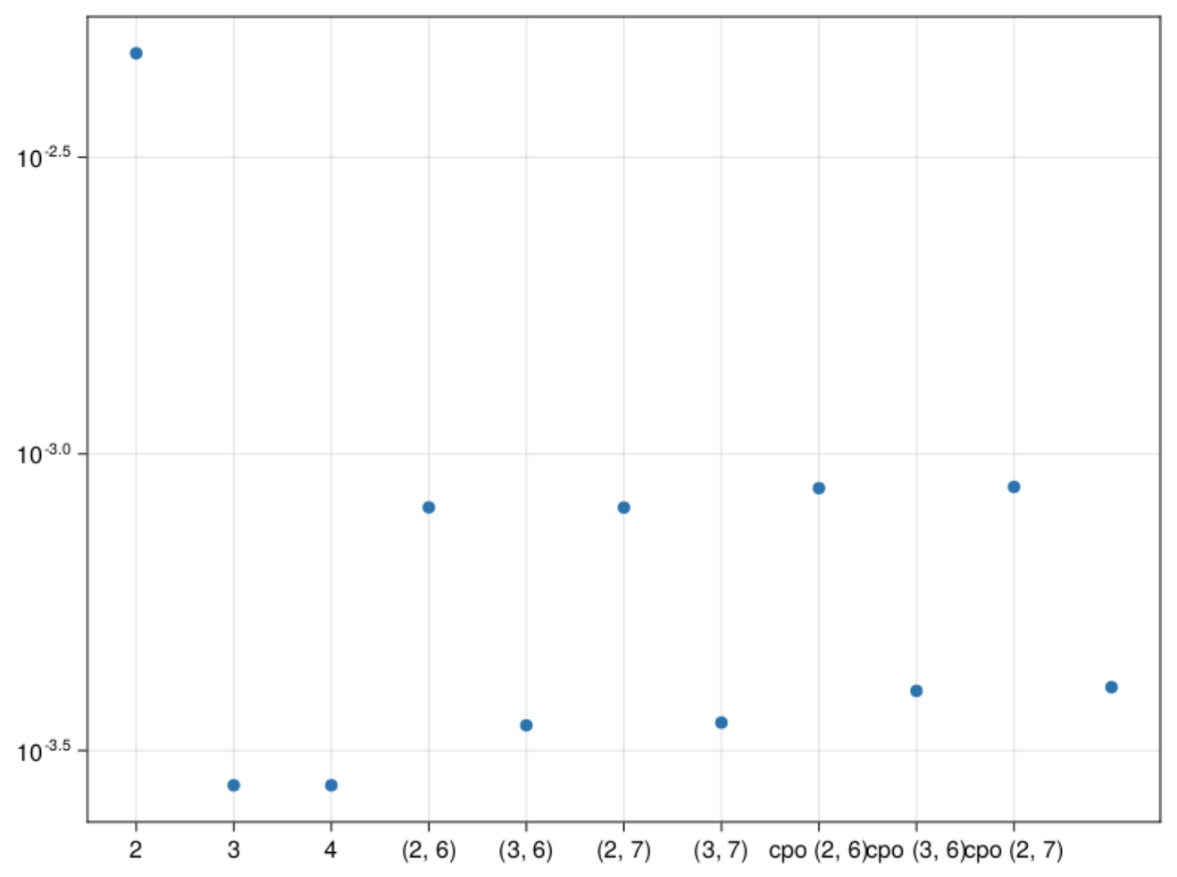
$\sin\left(αx\right)cos⁡(βy)$ error graph
2 – 2 stored moments
3 – 3 stored moments
(2,6) – 2 stored, 6 pseudo
(3,6) – 3 stored, 6 pseudo
(2,7) - 2 stored, 7 pseudo
(3,7) – 3 stored, 7 pseudo
cpo(2,6) – max cumulant order 2, order 6
cpo(3,6) – max cumulant order 3, order 6
cpo(2,7) – max cumulant order 3, order 7
cpo(3,7) – max cumulant order 3, order 7

Slide 38
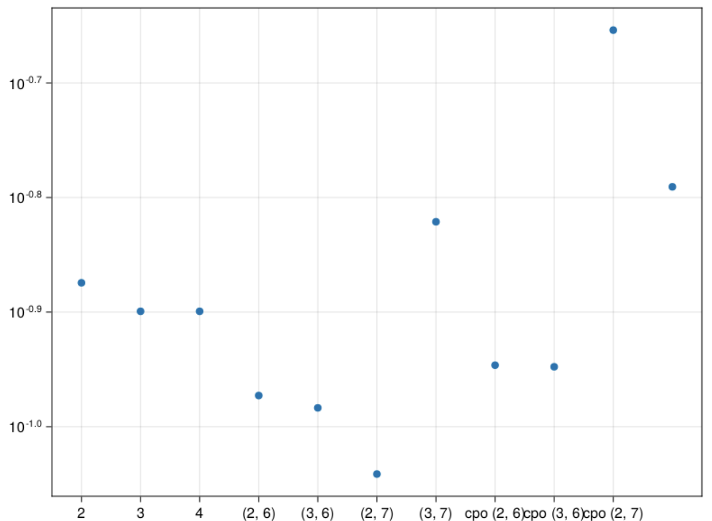
$\tan\left(αx+ βy\right)$ error graph
2 – 2 stored moments
3 – 3 stored moments
(2,6) – 2 stored, 6 pseudo
(3,6) – 3 stored, 6 pseudo
(2,7) - 2 stored, 7 pseudo
(3,7) – 3 stored, 7 pseudo
cpo(2,6) – max cumulant order 2, order 6
cpo(3,6) – max cumulant order 3, order 6
cpo(2,7) – max cumulant order 3, order 7
cpo(3,7) – max cumulant order 3, order 7

Slide 39
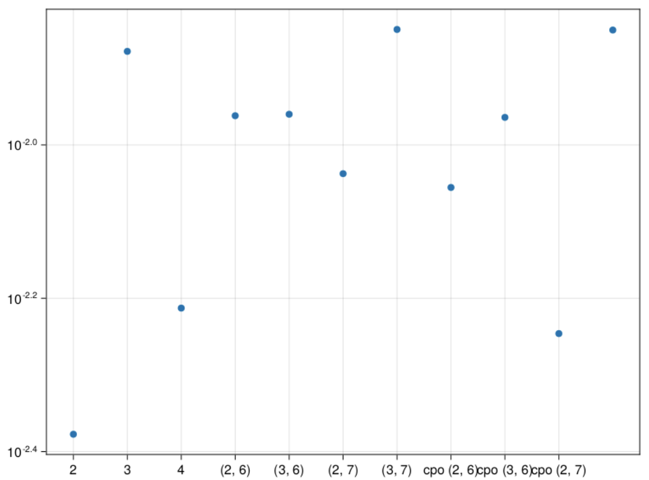
${αx}^{2}∗I\left(βy>0.3\right)$ error graph
2 – 2 stored moments
3 – 3 stored moments
(2,6) – 2 stored, 6 pseudo
(3,6) – 3 stored, 6 pseudo
(2,7) - 2 stored, 7 pseudo
(3,7) – 3 stored, 7 pseudo
cpo(2,6) – max cumulant order 2, order 6
cpo(3,6) – max cumulant order 3, order 6
cpo(2,7) – max cumulant order 3, order 7
cpo(3,7) – max cumulant order 3, order 7

Slide 40
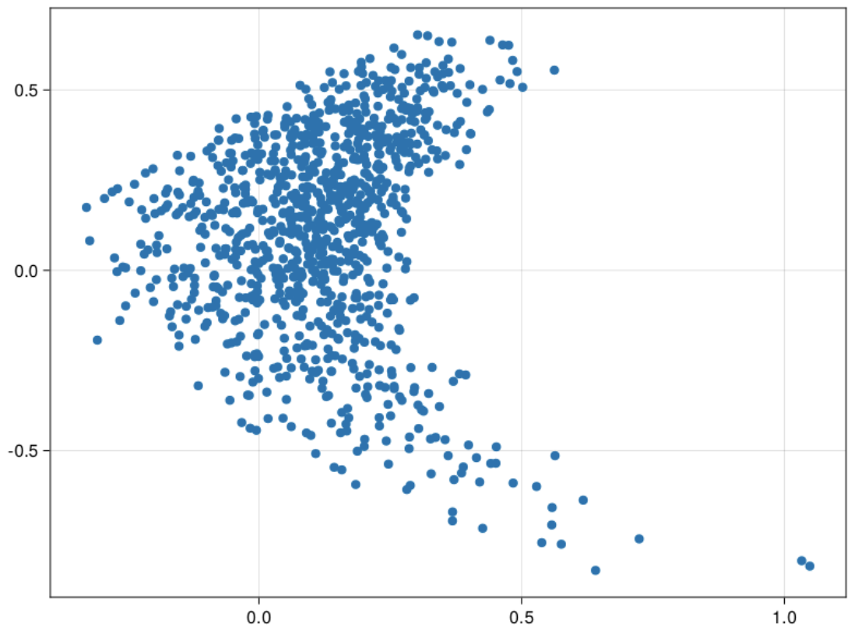
Scatter plot of Data
Z1 function – 0.7x^2 + 0.4y
Z2 function – sin(x)cos(y)
Skewness – (-4)

Slide 41
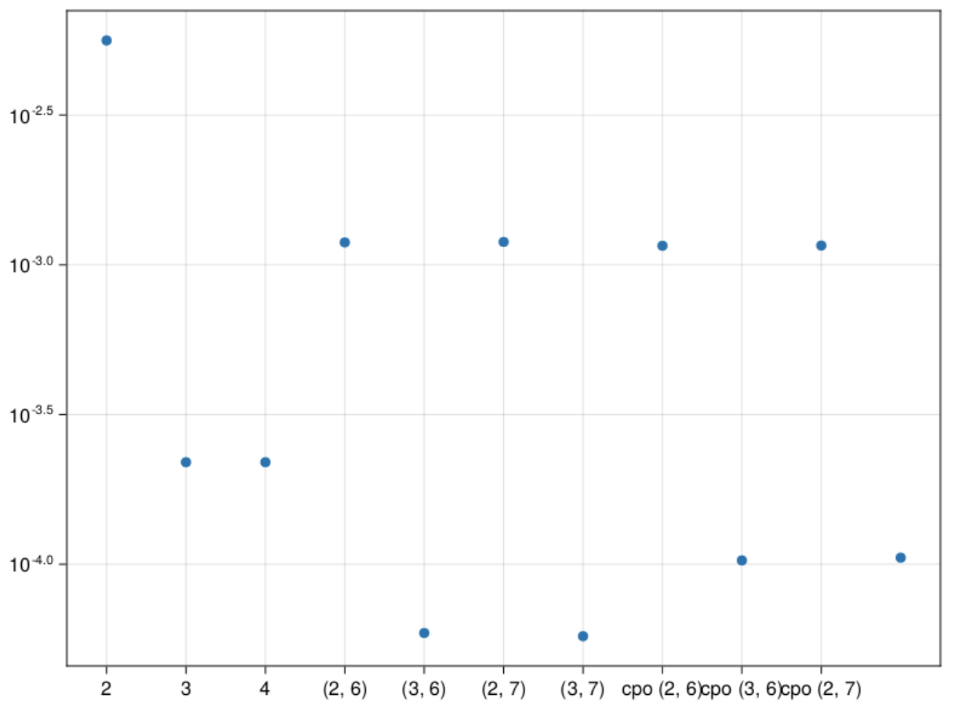
$\sin\left(αx\right)cos⁡(βy)$ error graph
2 – 2 stored moments
3 – 3 stored moments
(2,6) – 2 stored, 6 pseudo
(3,6) – 3 stored, 6 pseudo
(2,7) - 2 stored, 7 pseudo
(3,7) – 3 stored, 7 pseudo
cpo(2,6) – max cumulant order 2, order 6
cpo(3,6) – max cumulant order 3, order 6
cpo(2,7) – max cumulant order 3, order 7
cpo(3,7) – max cumulant order 3, order 7

Slide 42
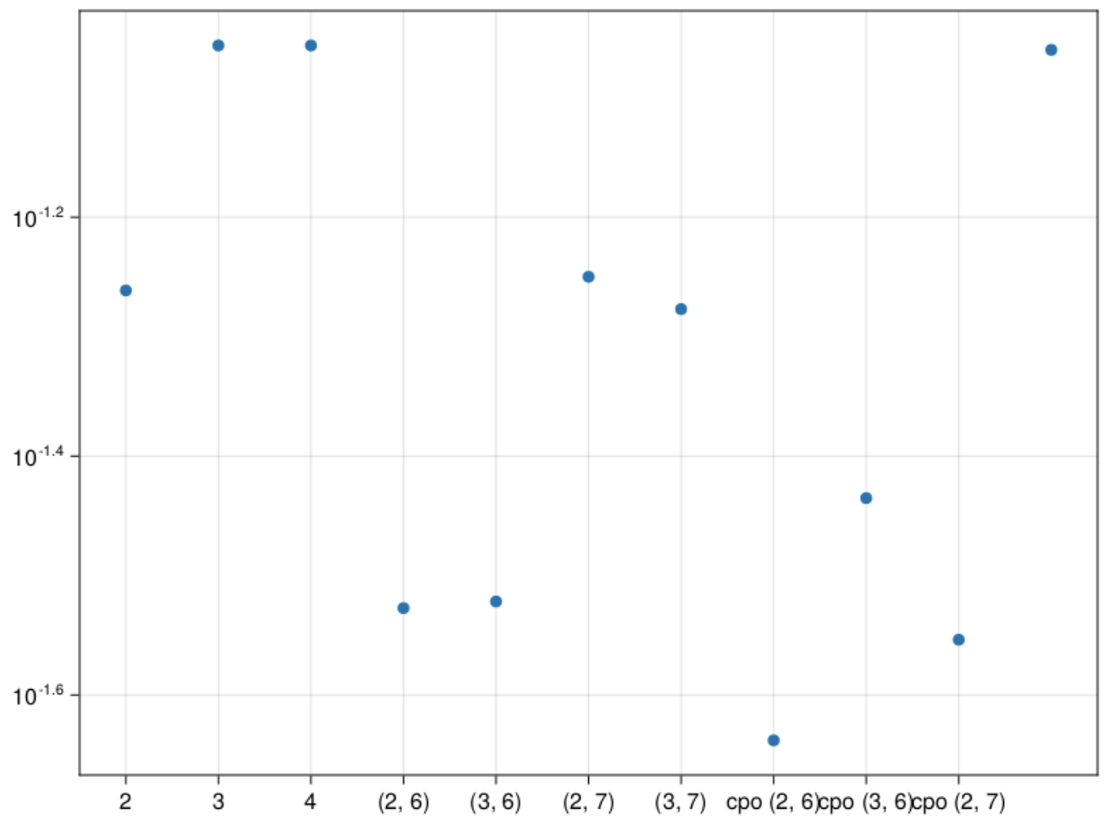
$\tan\left(αx+ βy\right)$ error graph
2 – 2 stored moments
3 – 3 stored moments
(2,6) – 2 stored, 6 pseudo
(3,6) – 3 stored, 6 pseudo
(2,7) - 2 stored, 7 pseudo
(3,7) – 3 stored, 7 pseudo
cpo(2,6) – max cumulant order 2, order 6
cpo(3,6) – max cumulant order 3, order 6
cpo(2,7) – max cumulant order 3, order 7
cpo(3,7) – max cumulant order 3, order 7

Slide 43
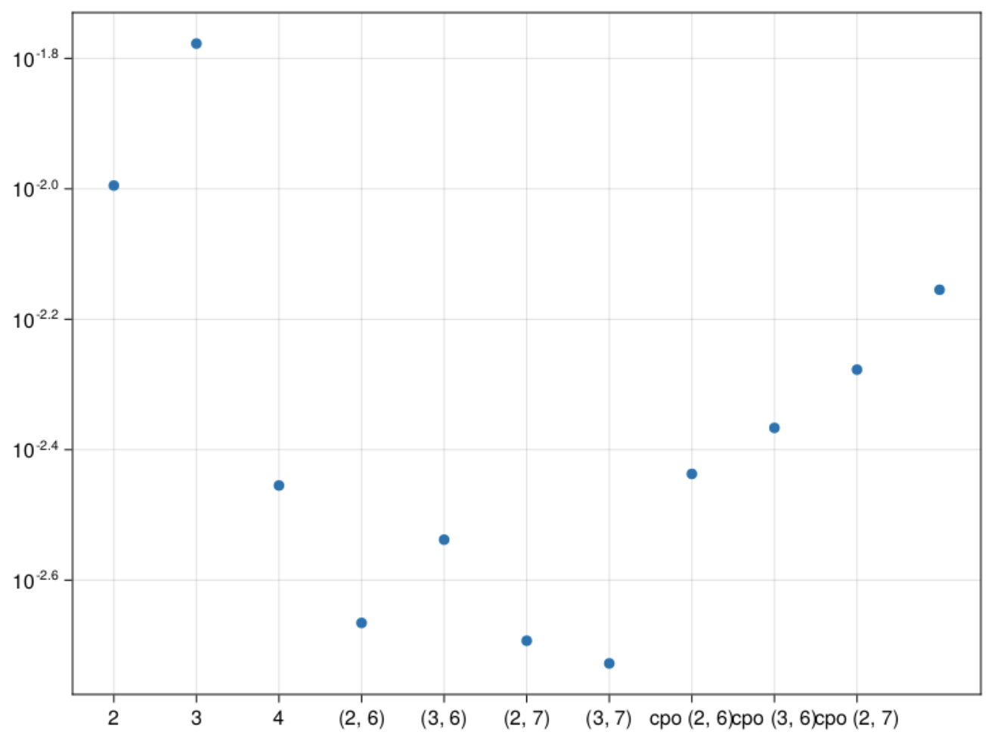
${αx}^{2}∗I\left(βy>0.3\right)$ error graph
2 – 2 stored moments
3 – 3 stored moments
(2,6) – 2 stored, 6 pseudo
(3,6) – 3 stored, 6 pseudo
(2,7) - 2 stored, 7 pseudo
(3,7) – 3 stored, 7 pseudo
cpo(2,6) – max cumulant order 2, order 6
cpo(3,6) – max cumulant order 3, order 6
cpo(2,7) – max cumulant order 3, order 7
cpo(3,7) – max cumulant order 3, order 7

Slide 44
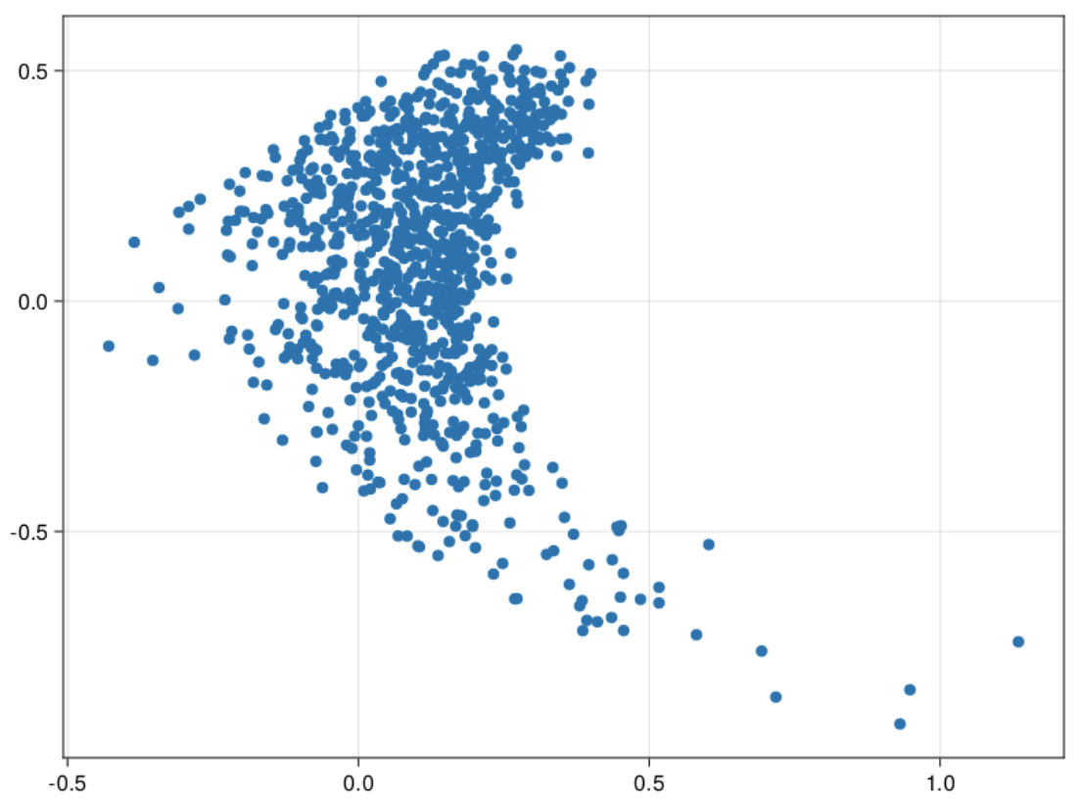
Scatter plot of Data
Z1 function – 0.7x^2 + 0.4y
Z2 function – sin(x)cos(y)
Skewness – (-8)

Slide 45
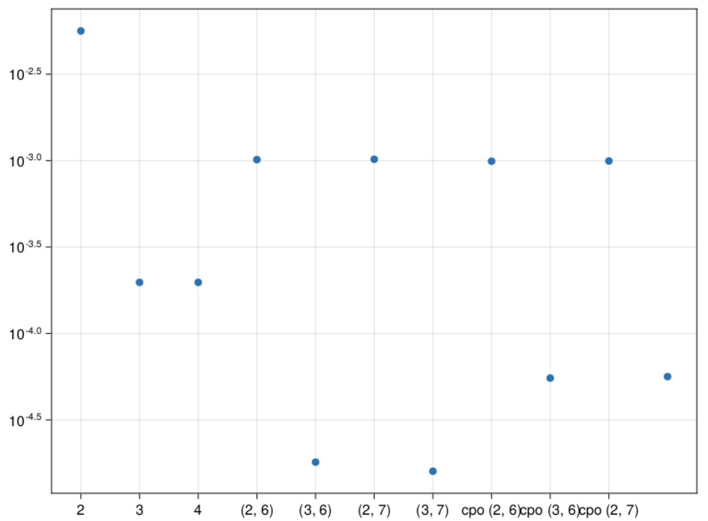
$\sin\left(αx\right)cos⁡(βy)$ error graph
2 – 2 stored moments
3 – 3 stored moments
(2,6) – 2 stored, 6 pseudo
(3,6) – 3 stored, 6 pseudo
(2,7) - 2 stored, 7 pseudo
(3,7) – 3 stored, 7 pseudo
cpo(2,6) – max cumulant order 2, order 6
cpo(3,6) – max cumulant order 3, order 6
cpo(2,7) – max cumulant order 3, order 7
cpo(3,7) – max cumulant order 3, order 7

Slide 46
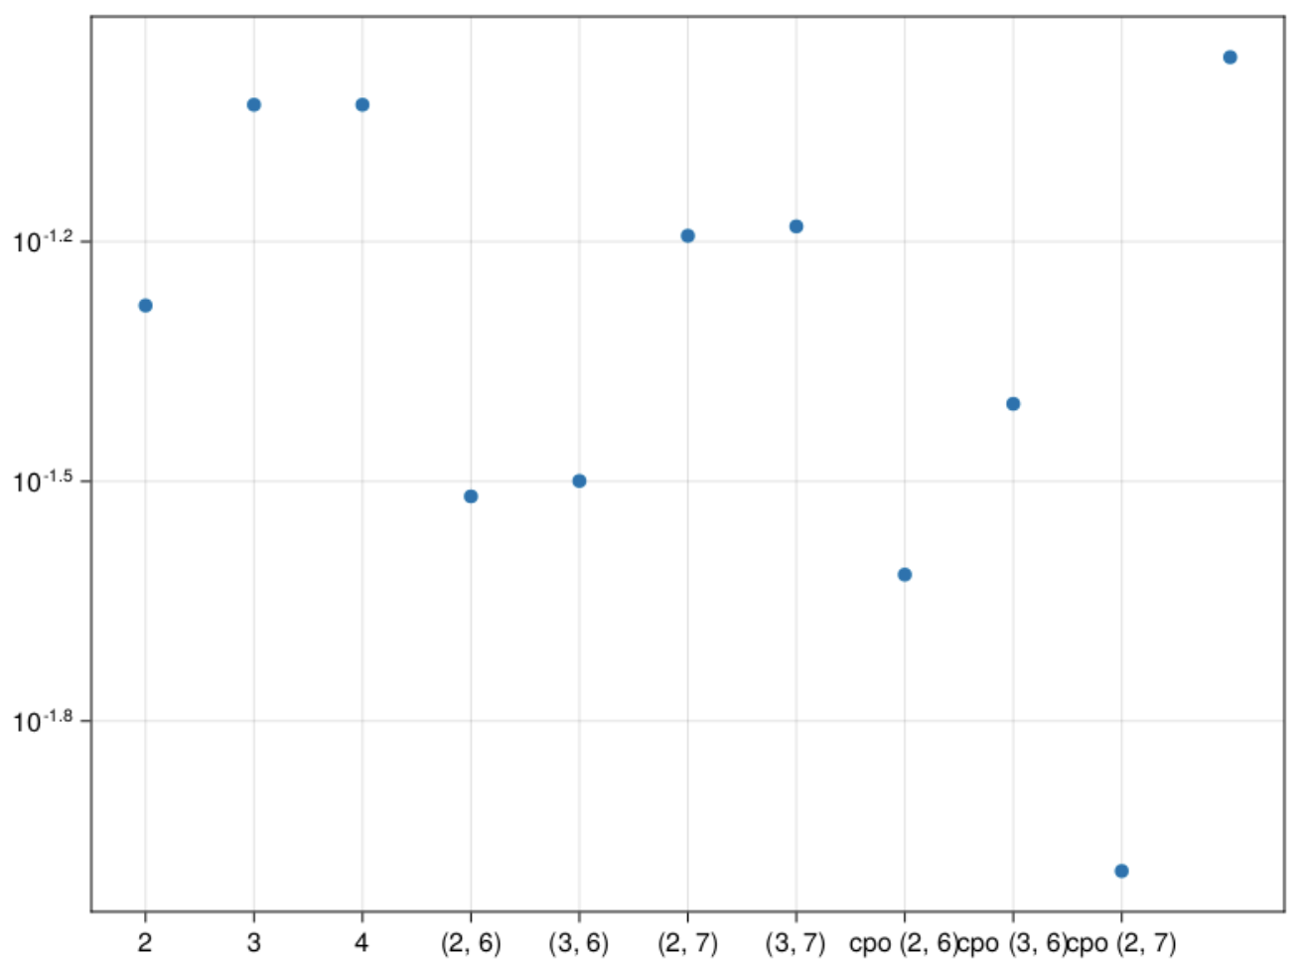
$\tan\left(αx+ βy\right)$ error graph
2 – 2 stored moments
3 – 3 stored moments
(2,6) – 2 stored, 6 pseudo
(3,6) – 3 stored, 6 pseudo
(2,7) - 2 stored, 7 pseudo
(3,7) – 3 stored, 7 pseudo
cpo(2,6) – max cumulant order 2, order 6
cpo(3,6) – max cumulant order 3, order 6
cpo(2,7) – max cumulant order 3, order 7
cpo(3,7) – max cumulant order 3, order 7

Slide 47
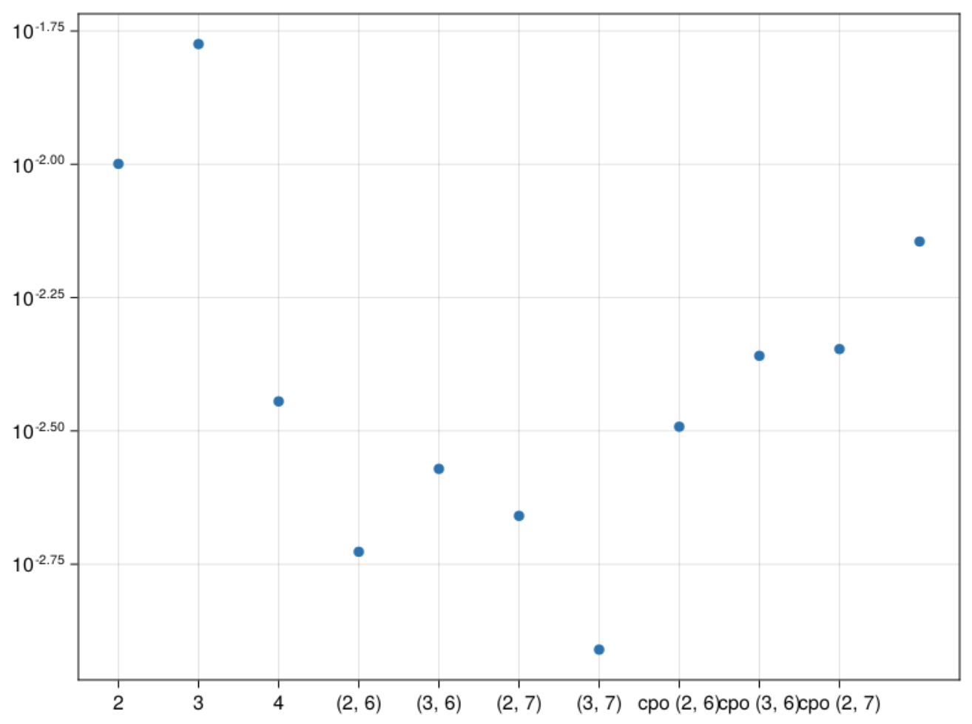
${αx}^{2}∗I\left(βy>0.3\right)$ error graph
2 – 2 stored moments
3 – 3 stored moments
(2,6) – 2 stored, 6 pseudo
(3,6) – 3 stored, 6 pseudo
(2,7) - 2 stored, 7 pseudo
(3,7) – 3 stored, 7 pseudo
cpo(2,6) – max cumulant order 2, order 6
cpo(3,6) – max cumulant order 3, order 6
cpo(2,7) – max cumulant order 3, order 7
cpo(3,7) – max cumulant order 3, order 7

Slide 48
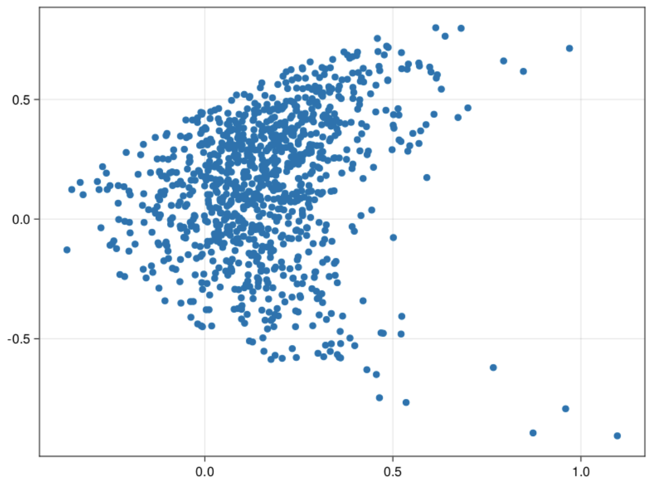
Scatter plot of Data
Z1 function – 0.7x^2 + 0.4y
Z2 function – sin(x)cos(y)
Skewness – (-2)

Slide 49

$\sin\left(αx\right)cos⁡(βy)$ error graph
2 – 2 stored moments
3 – 3 stored moments
(2,6) – 2 stored, 6 pseudo
(3,6) – 3 stored, 6 pseudo
(2,7) - 2 stored, 7 pseudo
(3,7) – 3 stored, 7 pseudo
cpo(2,6) – max cumulant order 2, order 6
cpo(3,6) – max cumulant order 3, order 6
cpo(2,7) – max cumulant order 3, order 7
cpo(3,7) – max cumulant order 3, order 7

Slide 50

$\tan\left(αx+ βy\right)$ error graph
2 – 2 stored moments
3 – 3 stored moments
(2,6) – 2 stored, 6 pseudo
(3,6) – 3 stored, 6 pseudo
(2,7) - 2 stored, 7 pseudo
(3,7) – 3 stored, 7 pseudo
cpo(2,6) – max cumulant order 2, order 6
cpo(3,6) – max cumulant order 3, order 6
cpo(2,7) – max cumulant order 3, order 7
cpo(3,7) – max cumulant order 3, order 7

Slide 51

${αx}^{2}∗I\left(βy>0.3\right)$ error graph
2 – 2 stored moments
3 – 3 stored moments
(2,6) – 2 stored, 6 pseudo
(3,6) – 3 stored, 6 pseudo
(2,7) - 2 stored, 7 pseudo
(3,7) – 3 stored, 7 pseudo
cpo(2,6) – max cumulant order 2, order 6
cpo(3,6) – max cumulant order 3, order 6
cpo(2,7) – max cumulant order 3, order 7
cpo(3,7) – max cumulant order 3, order 7

